Slide 1
LEARNING ENGINEERING
Sae Schatz, Ph.D. with Jim Goodell
Notes:
Sae Schatz, Ph.D.
sae.schatz@gmail.com
+1 407-920-4981
Timing: 45 minutes presentation, break, 45 minutes Q&A
0:00-0:03 3 min – Introduction
0:03-0:10 7 min – Process
0:10-0:14 4 min – Team
0:14-0:19 5 min – HCD
0:19-0:23 4 min – Learning Science
0:23-0:28 6 min – Tech and Data
0:28-0:30 2 min – Summary

Slide 2




Sae Schatz
Sae (pronounced like “Say”) works at the intersection of learning and development, technology, and data. She’s currently the co-founder and chief product officer of Bedrock Learning, Inc. From 2015 to 2022, she served as the director of DoD’s Advanced Distributed Learning (ADL) Initiative, where she grew the program grew its impact across the US and international defense sectors and sparked the community’s pursuit of the “future learning ecosystem.”
WWW
www.thebedrock.co
@
sae.schatz@gmail.com
https://www.linkedin.com/in/saeschatz
Notes:
Sae Schatz (pronounced like “Say”) works at the intersection of learning and development, technology, and data. She’s currently the co-founder and Chief Product Officer of Bedrock Learning, Inc. From 2015 to 2022, she served as the director of the Advanced Distributed Learning (ADL) Initiative, a government program for research, development, and policy stewardship. Under her leadership, the program grew its impact across the US and international defense sectors, and she sparked the community’s pursuit of the “future learning ecosystem.” Before joining the civil service, Sae worked as an applied human–systems scientist in both business and academia, and she formerly held an assistant professorship with the University of Central Florida’s Institute for Simulation and Training. Sae is a prolific writer and professional presenter as well as an accomplished graphic designer who often uses those skills to enhance books, presentations, and infographics.

Slide 3
learning engineering [ˈlərniNG ˌenjəˈniriNG]
Learning engineering is a process and practice that applies the
learning sciences, using human-centered engineering design methodologies and data-informed decision-making, to support learners and their development.
Goodell et al. (2022), Learning Engineering Toolkit
Notes:
In other words, it’s about solving problems related to learning and development – at a system level – with all of the tools in a toolkit

Slide 4
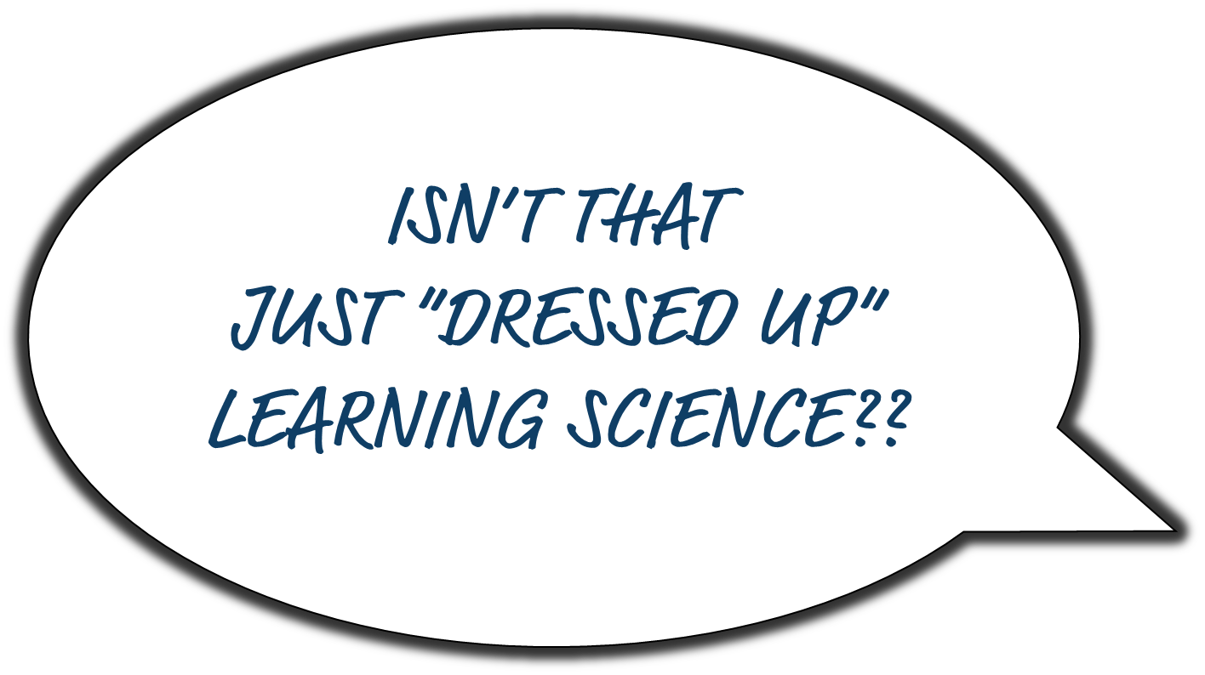

learning engineering [ˈlərniNG ˌenjəˈniriNG]
Learning engineering is a process and practice that applies the
learning sciences, using human-centered engineering design methodologies and data-informed decision-making, to support learners and their development.
Goodell et al. (2022), Learning Engineering Toolkit
Notes:
Now wait a minute. Isn’t this just a talk about “fancy learning science”?

Slide 5

Learning Science
Learning Engineering
Notes:
Science vs. Engineering…

Slide 6

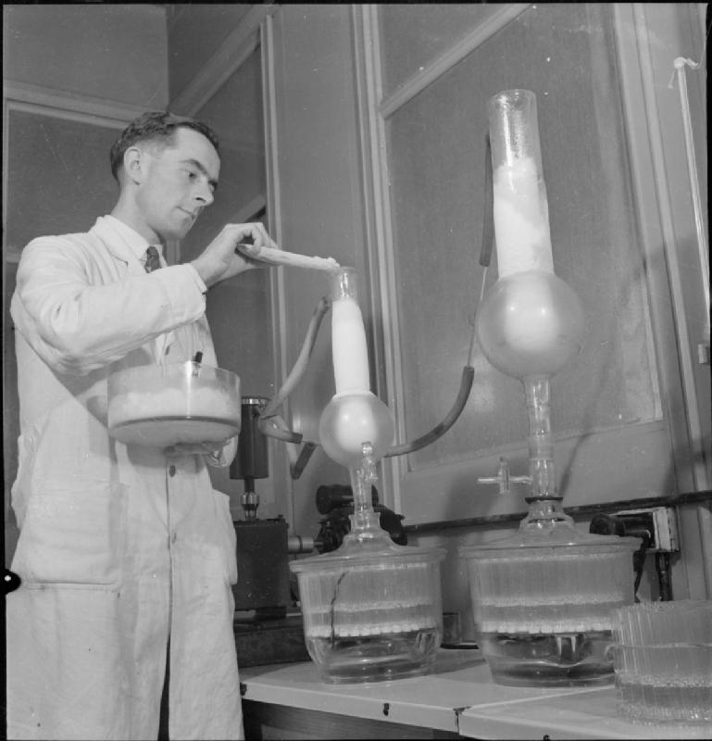
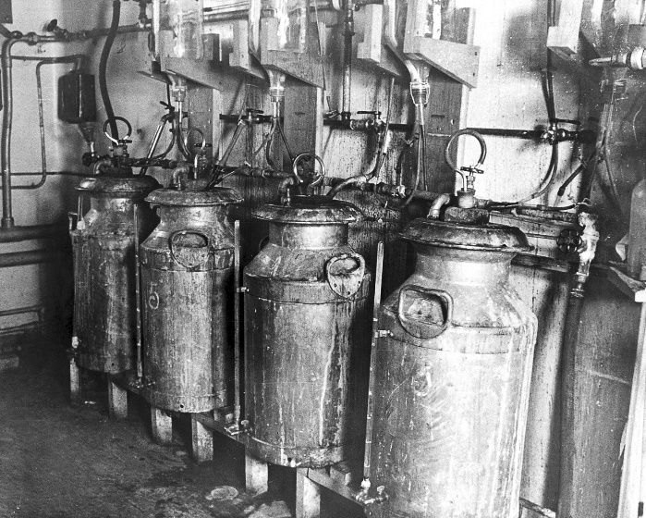
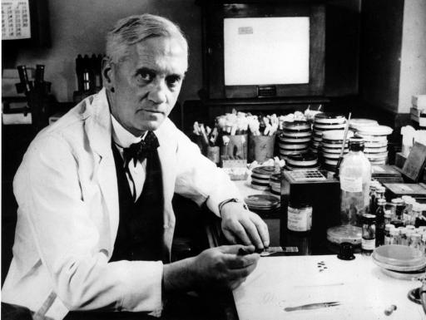
Engineers Begin to Scale
1928
WWII
First Factory Opens
Dr. Alexander Fleming
1939
1941
1944
Notes:
In 1928, Alexander Fleming discovered penicillin. However, the Nobel Prize–winning scientist and his colleagues never developed the ability to produce the drug at scale. By June 1942, US labs had only enough penicillin available to treat about ten patients. The urgency of lives being lost in the war meant that production of penicillin needed to move out of the laboratory and into mass-production. This was no longer just a scientific endeavor; it required engineering. The goals of science and engineering are different. The goal of science is to discover the truth about the world as it is. The goal of engineering is to create scalable solutions to problems using science as one tool in that endeavor.
PHOTOS:
Engineering photo (“at scale”) from Imperial War Museum on the IWM Non Commercial Licence.
Equipment used for making early forms of penicillin photo from Wellcome Images. Creative commons.
Penicillin Discovered
“In the war, penicillin proved its mettle. Throughout history, the major killer in wars had been infection rather than battle injuries. In World War I, the death rate from bacterial pneumonia was 18 percent; in World War II, it fell, to less than 1 percent. From January to May in 1942, 400 million units of pure penicillin were manufactured. By the end of the war, American pharmaceutical companies were producing 650 billion units a month. …as we celebrate Alexander Fleming’s great accomplishment, we will recall that penicillin also required the midwifery of Florey, Chain and Heatley, as well as an army of laboratory workers.” (PBS, 2013, https://www.pbs.org/newshour/health/the-real-story-behind-the-worlds-first-antibiotic)
First Factory Opened
“In September 1943 it [Pfizer] purchased the old Rubel Ice Plant on Marcy Avenue in Brooklyn, a nearby building that had the refrigeration equipment required, rebuilding it into the world’s first large-scale penicillin factory. On March 1, 1944 Pfizer’s penicillin plant opened.” (https://www.acs.org/content/acs/en/education/whatischemistry/landmarks/penicillin.html#:~:text=In%20September%201943%20it%20purchased,1944%20Pfizer's%20penicillin%20plant%20opened.)

Slide 7


Engineers Begin to Scale
Science
Engineering
1928
The goal of science is to discover the truth about the world as it is.
The goal of engineering is to create scalable solutions to problems using science as one tool in that endeavor.
WWII
First Factory Opens
Dr. Alexander Fleming
1939
1941
1944
Notes:
The goals of science and engineering are different. The goal of science is to discover the truth about the world as it is. The goal of engineering is to create scalable solutions to problems using science as one tool in that endeavor.
Explain what Learning Engineering is
Compare and contrast it to related disciplines
Determine initial steps to start a team project
Know where to find other resources

Slide 8

learning engineering [ˈlərniNG ˌenjəˈniriNG]
Learning engineering is a process and practice that applies the
learning sciences, using human-centered engineering design methodologies and data-informed decision-making, to support learners and their development.
Learning engineering is a repeatable process intended to iteratively design, test, adjust, and improve conditions for learning.
Goodell et al. (2022), Learning Engineering Toolkit
Notes:
Learning engineering is a process...

Slide 9



A process is a series of actions or steps taken in order to achieve a particular end.
A process has:
inputs
process steps
outputs

Slide 10






An iterative process uses feedback loops to continuously inform and improve the output.

Slide 11
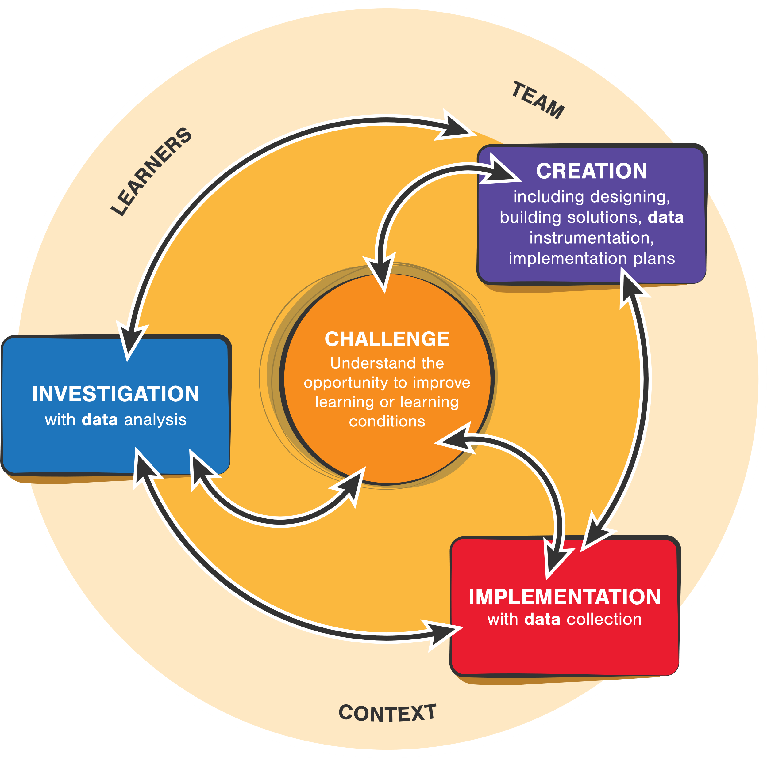
Learning engineering is a contextualized, iterative, data-driven, outcomes-focused process
CC-BY Aaron Kessler and Jim Goodell
Notes:
This is the learning engineering process diagram… let’s walk through it.

Slide 12
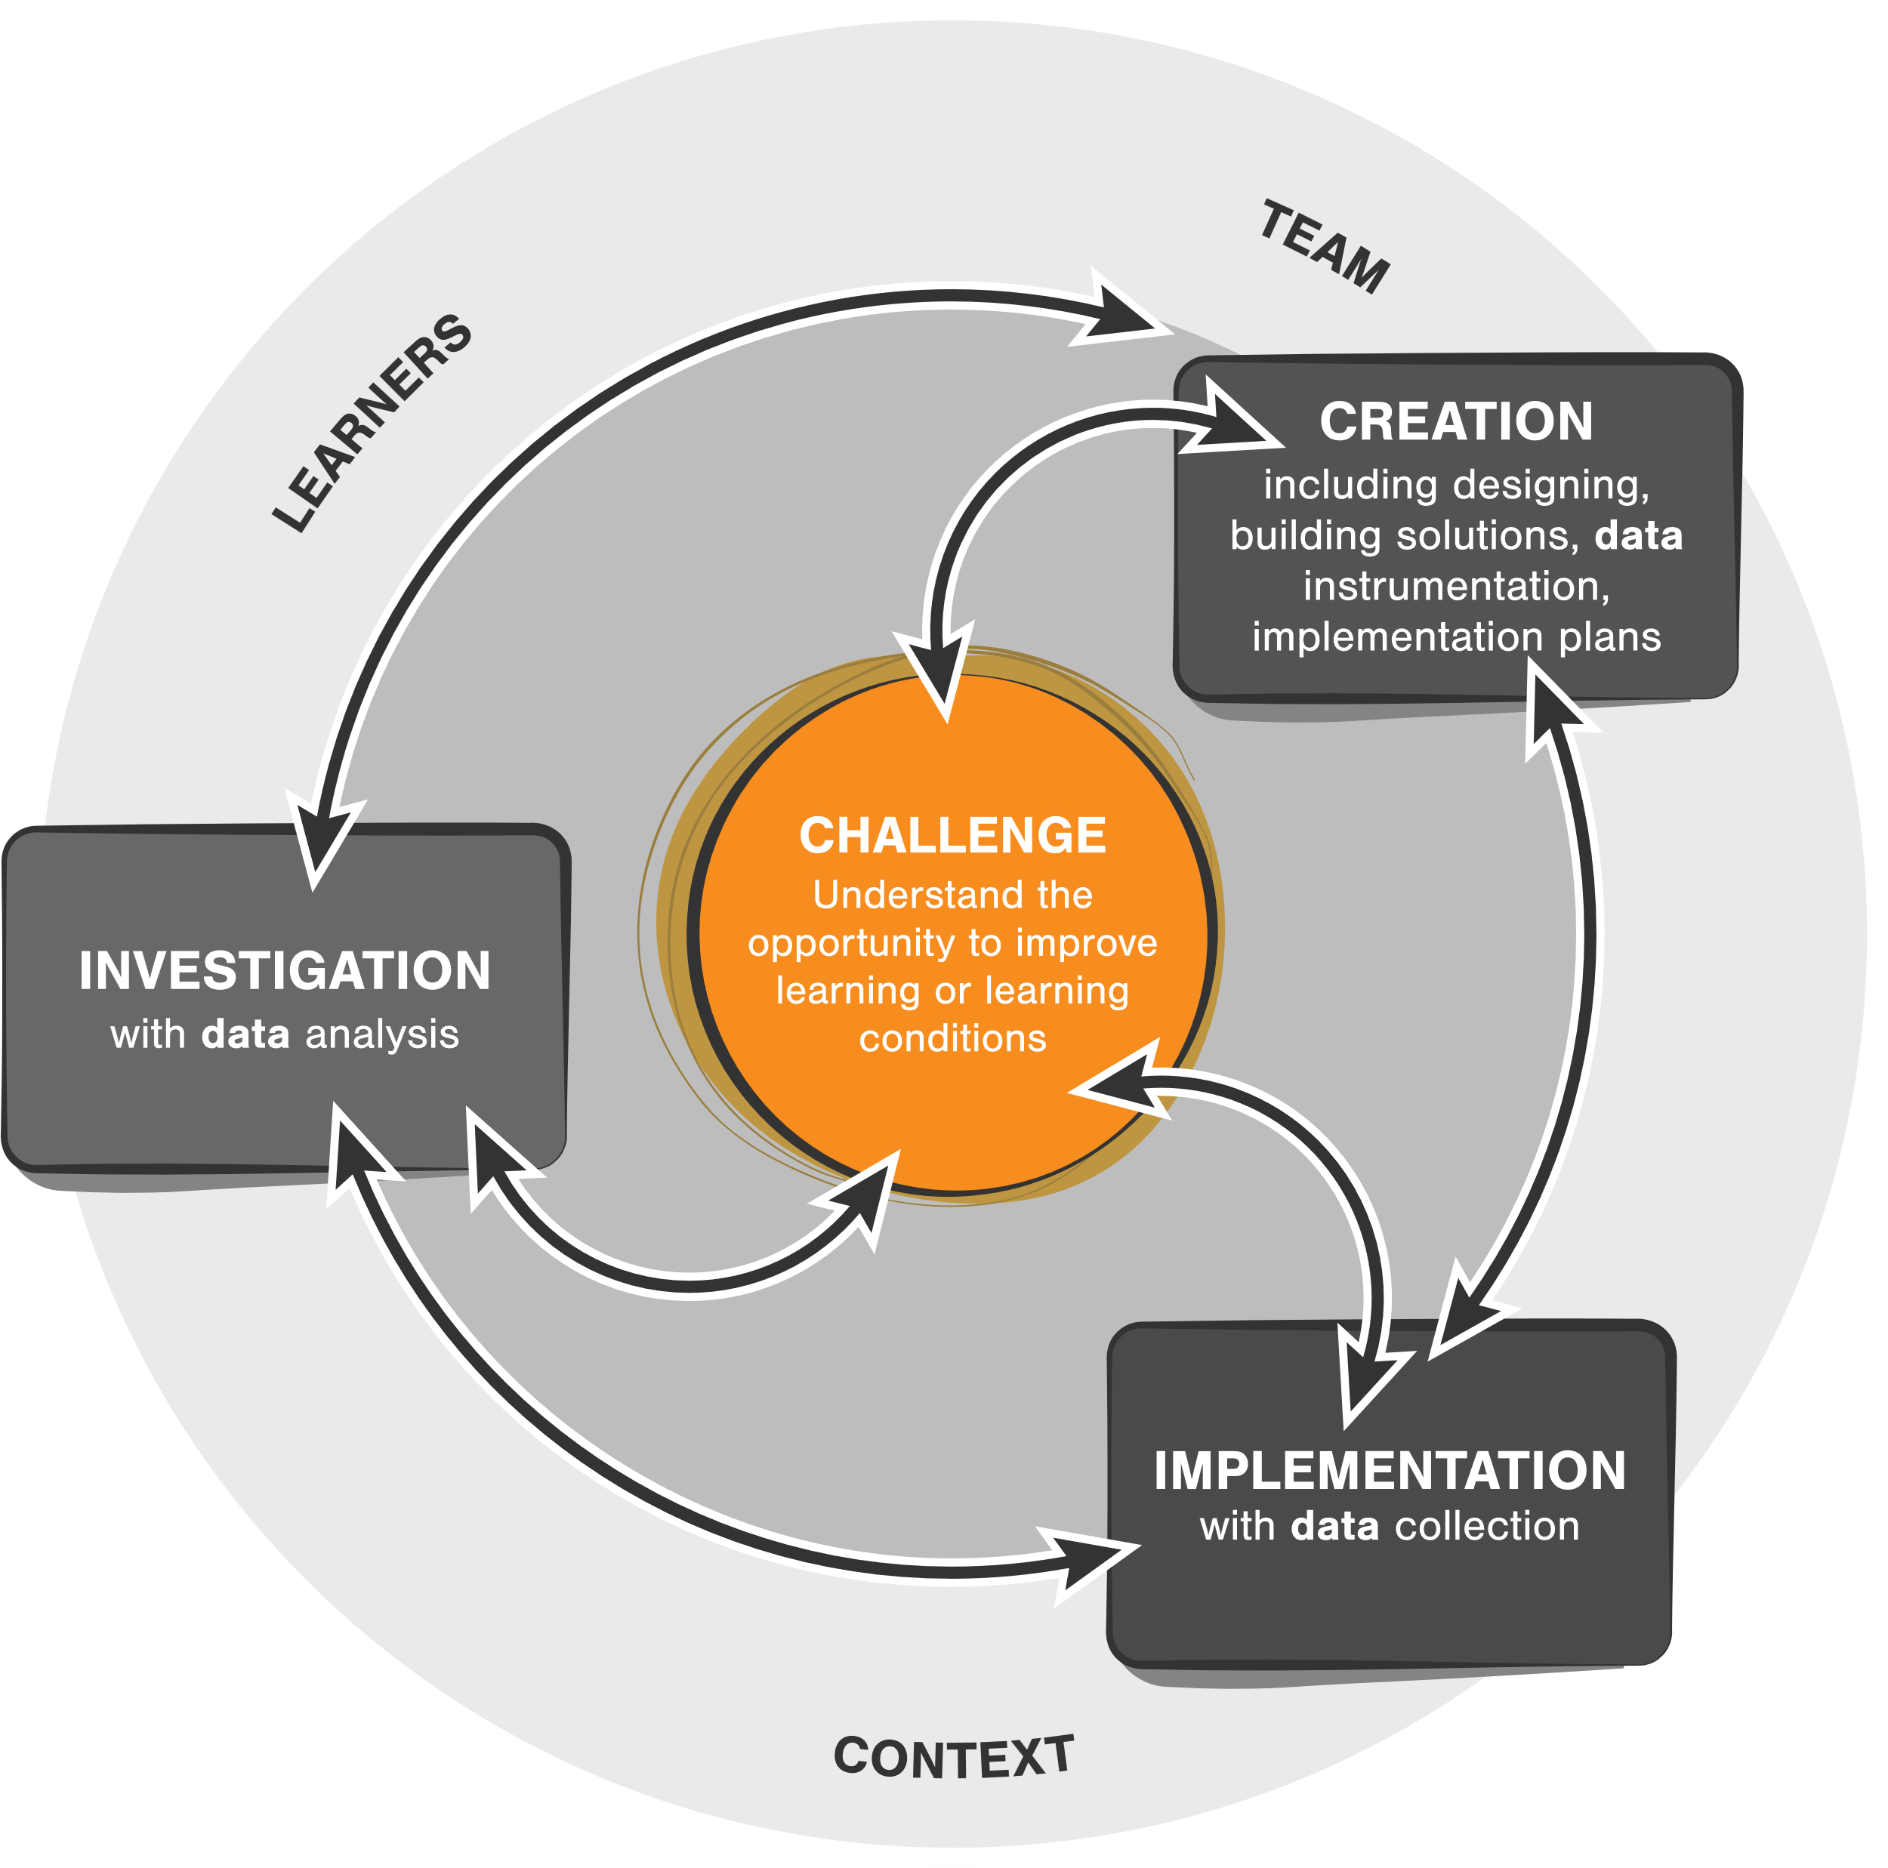
Start with the challenge or problem associated with learners and learning; in other words, be goal oriented
CC-BY Aaron Kessler and Jim Goodell

Slide 13
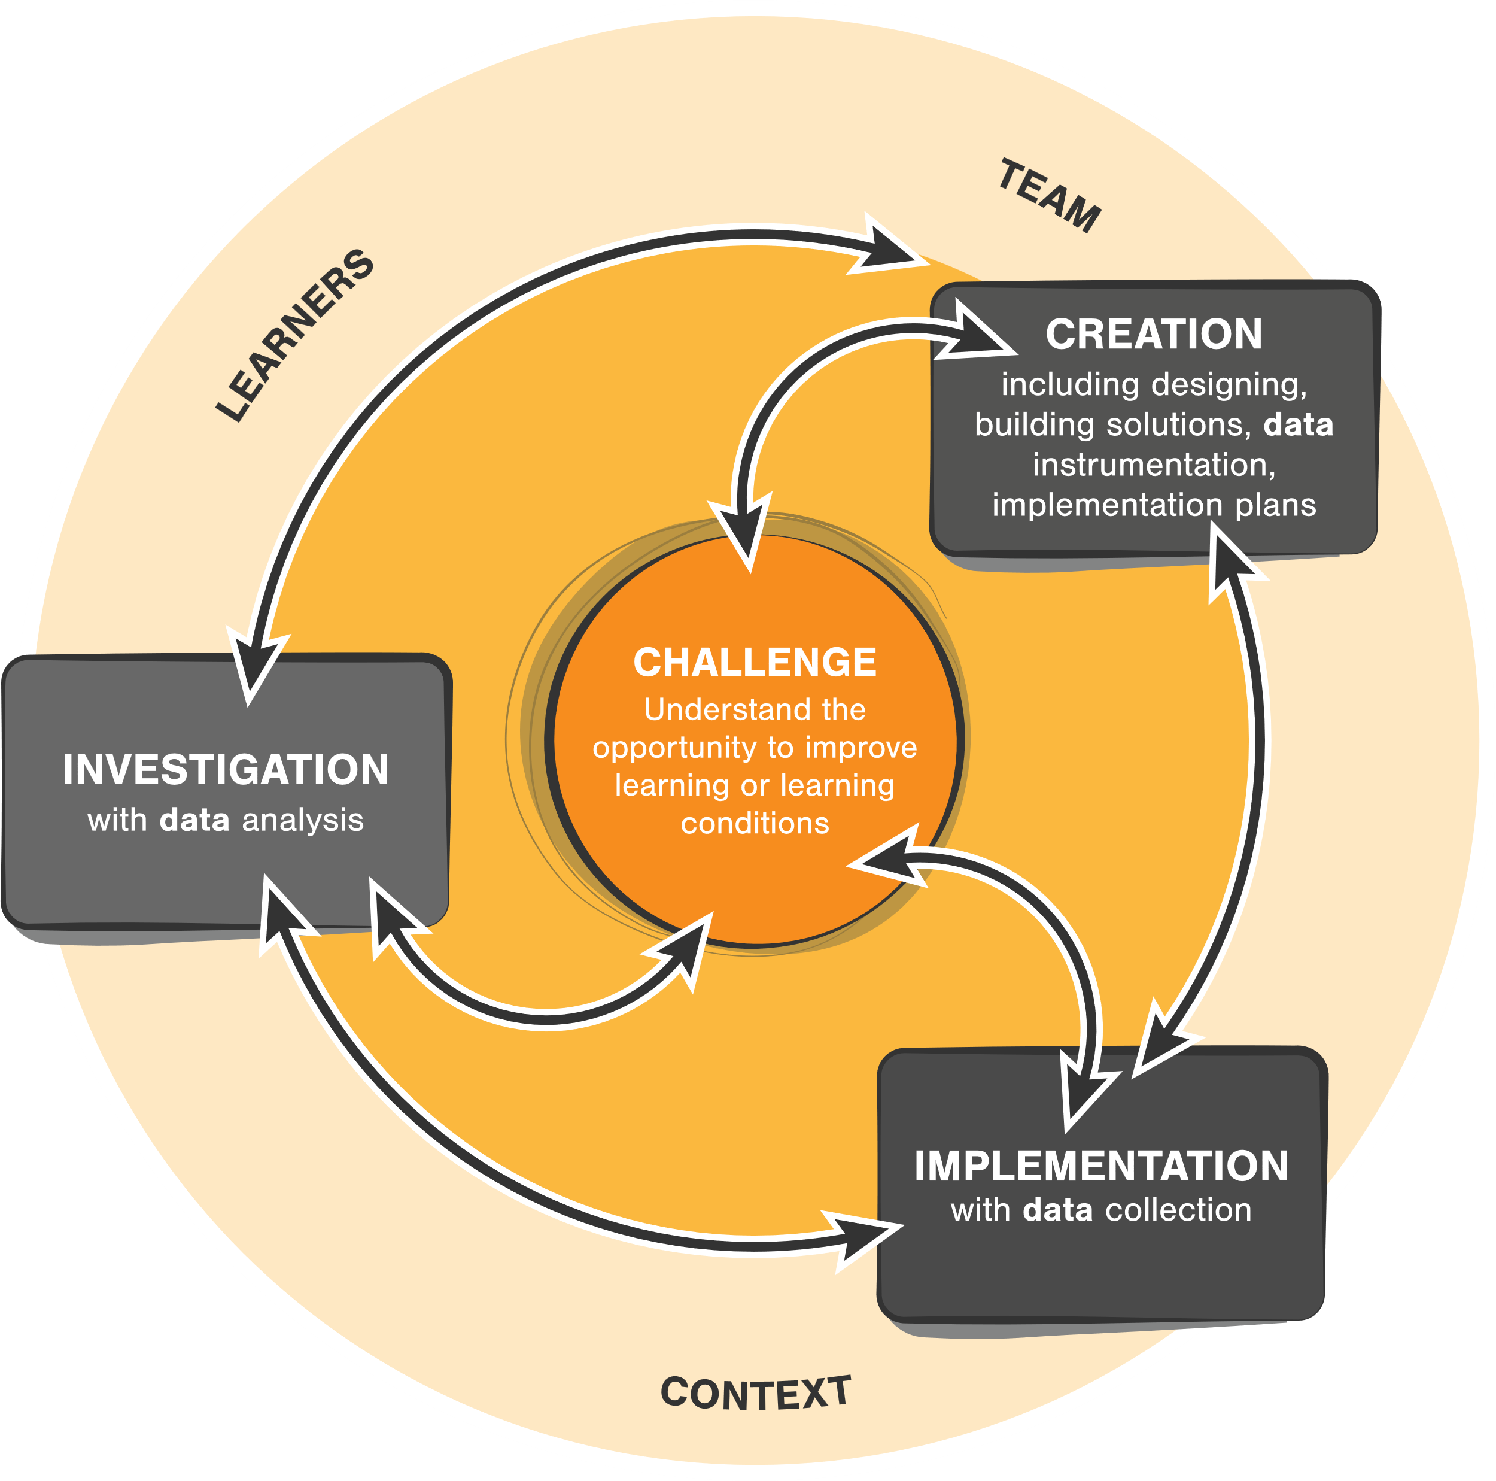
Start with the challenge or problem associated with learners and learning; in other words, be goal oriented
Learning is situated. Understand the context, not only the learners and content but of the full system
CC-BY Aaron Kessler and Jim Goodell

Slide 14
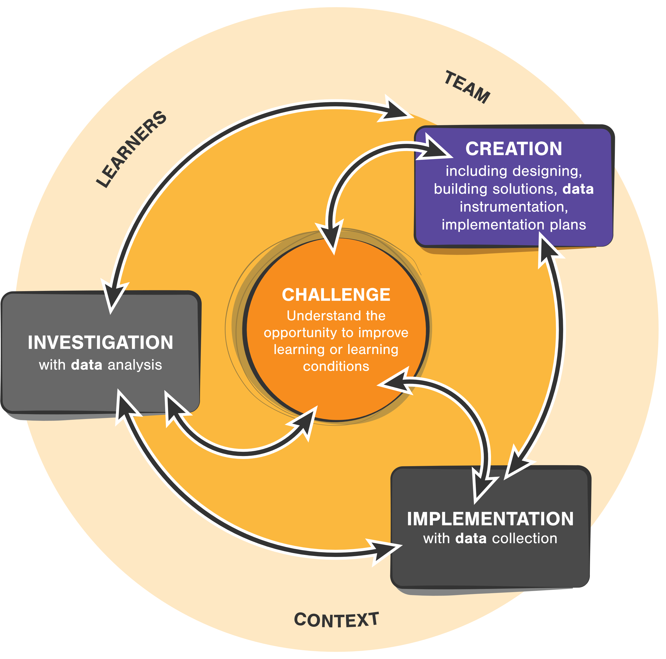
Start with the challenge or problem associated with learners and learning; in other words, be goal oriented
Learning is situated. Understand the context, not only the learners and content but of the full system
Design, develop, instrument, test in a series of mini processes
CC-BY Aaron Kessler and Jim Goodell

Slide 15
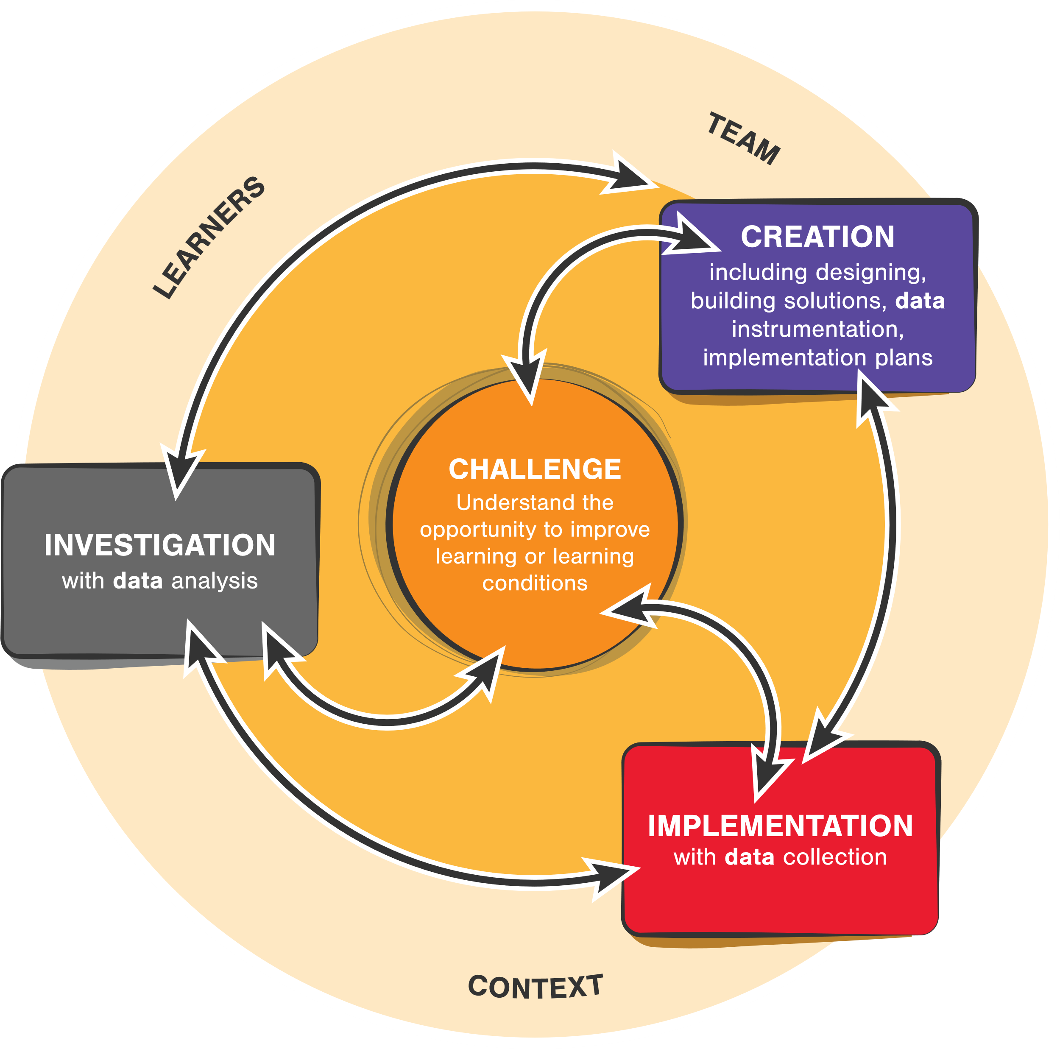
Start with the challenge or problem associated with learners and learning; in other words, be goal oriented
Learning is situated. Understand the context, not only the learners and content but of the full system
Design, develop, instrument, test in a series of mini processes
Implement with real learners in real contexts—with drafts and prototypes and also iteratively once released
CC-BY Aaron Kessler and Jim Goodell

Slide 16
Start with the challenge or problem associated with learners and learning; in other words, be goal oriented
Learning is situated. Understand the context, not only the learners and content but of the full system
Design, develop, instrument, test in a series of mini processes
Implement with real learners in real contexts—with drafts and prototypes and also iteratively once released
Collect data, analyze, identify ways to continuously improve
CC-BY Aaron Kessler and Jim Goodell

Slide 17
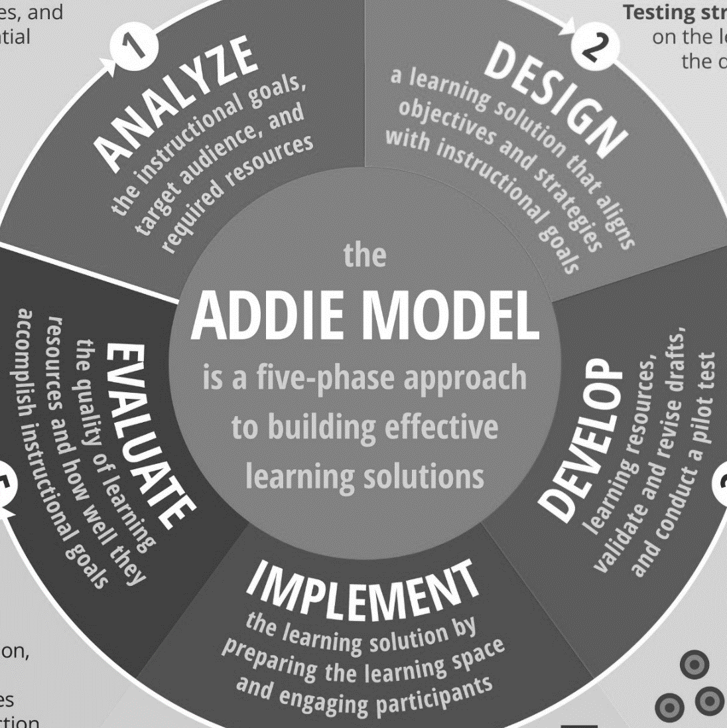
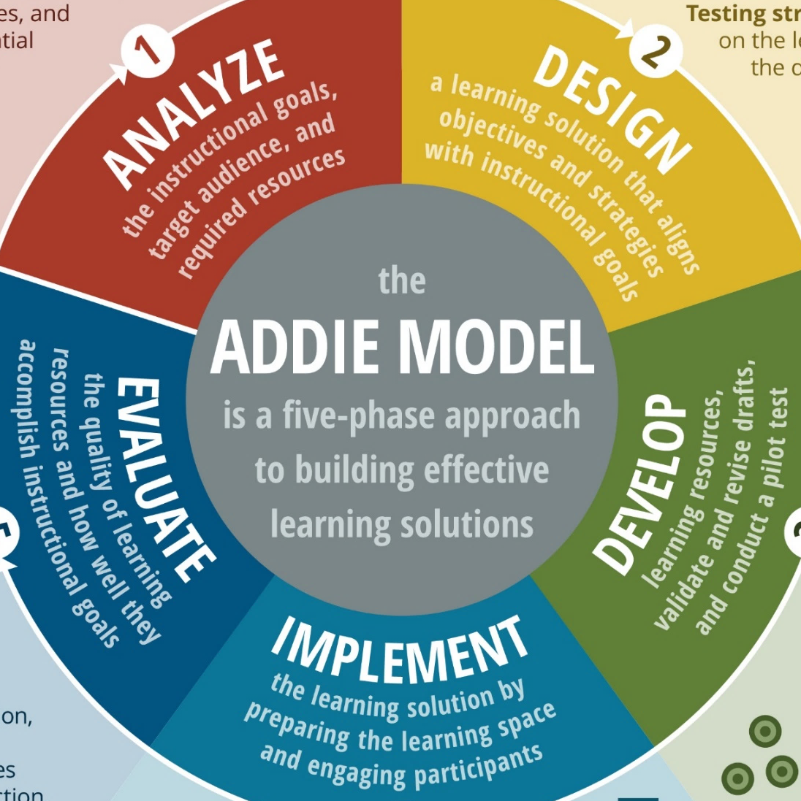
ADDIE and
Instructional Design
Learning Engineering
Process
vs
Notes:
You might be wondering, how does learning engineering compare to ADDIE?

Slide 18



Tends to be content focused
Tends to be linear
Once product is created, it ends
More limited in scope
Includes explicit assessments
Lacks emphasis on data
Is outcomes focused
Is iterative and concurrent
Continuous improvement
Broader, contextual scope
Assessments + instrumentation
Focuses on data throughout
vs
Notes:
Warning: Of course, there are great practitioners who use ADDIE effectively. So, this is a little exaggerated for effect. However, the ADDIE process, in real-world practice, is often diluted as you see highlighted on this slide. That’s not to say that everyone who uses ADDIE makes data-less or linear content.

Slide 19





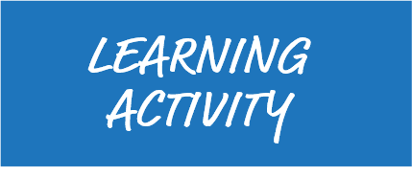



Notes:
The standard Input-Process-Output (IPO) model can be directly used within a learning context.

Slide 20

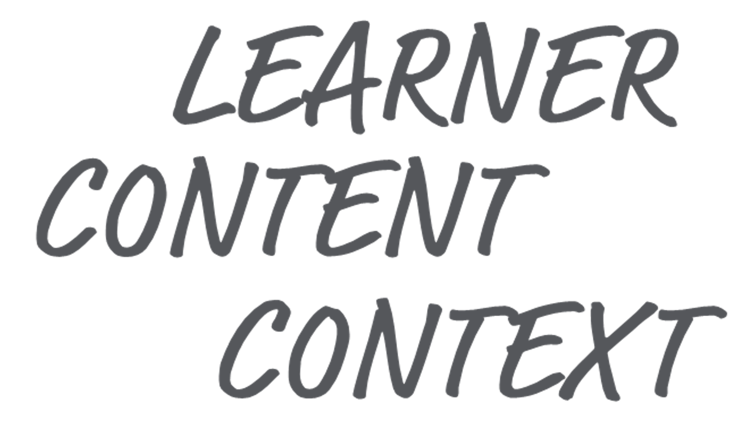





Notes:
That IPO model can occur at the learning activity (e.g., a single math problem) level, and many of those learning activities might occur in a course. The IPO model can also apply at the course level.

Slide 21

Notes:
Many courses might comprise a credential, like a university degree. And the IPO model can also apply at that feedback loop level.

Slide 22


Notes:
And many credentials might comprise a career. The model can apply to upskill and life-long learning within a career field.

Slide 23


Notes:
And we all might have several different careers within our lifetime, and the IPO process can even apply at that scale.

Slide 24

Notes:
OK, so that sounds pretty complicated. Who’s doing all of this??

Slide 25

Learning engineer as consultant
Learning engineer as a member of a team to coordinate across specialists
Notes:
The likelihood that you’ll find a unicorn—a single person who can do all of the parts of the LE process—is unlikely. It’s possible that you might have someone who is an LE specialist who consults with a team or who, at least, represents the LE perspective on a multi-displinary IPT.

Slide 26

Learning engineering team: Multiple professionals with a base set of common competencies and shared vocabularies, with different roles and areas of expertise
Notes:
In all likelihood, an LE team will be comprised of multiple learning engineering professionals, each having a base set of common competencies and shared vocabularies for the practice of learning engineering while having different roles and areas of expertise

Slide 27







Assessment, Measurement, Evaluation Expertise
Subject-matter Expertise
Learning Sciences
Data Science
Software Engineering
Learning Experience Design
Learning Environment Engineering
Education and Training Professionals
Where are you in this line-up?
Notes:
Learning engineering is a team sport requiring expertise from different fields, including
Learning sciences
Learning experience design
Learning environment engineering
Education and training professionals
Assessment, measurement, evaluation
Data science
Software engineering
Subject-matter expertise

Slide 28

Notes:
Critically, this team needs to have a base set of understanding about LE and shared understanding—that is, actively working toward the same unified goal, not just executing their individual tasks in silos.

Slide 29
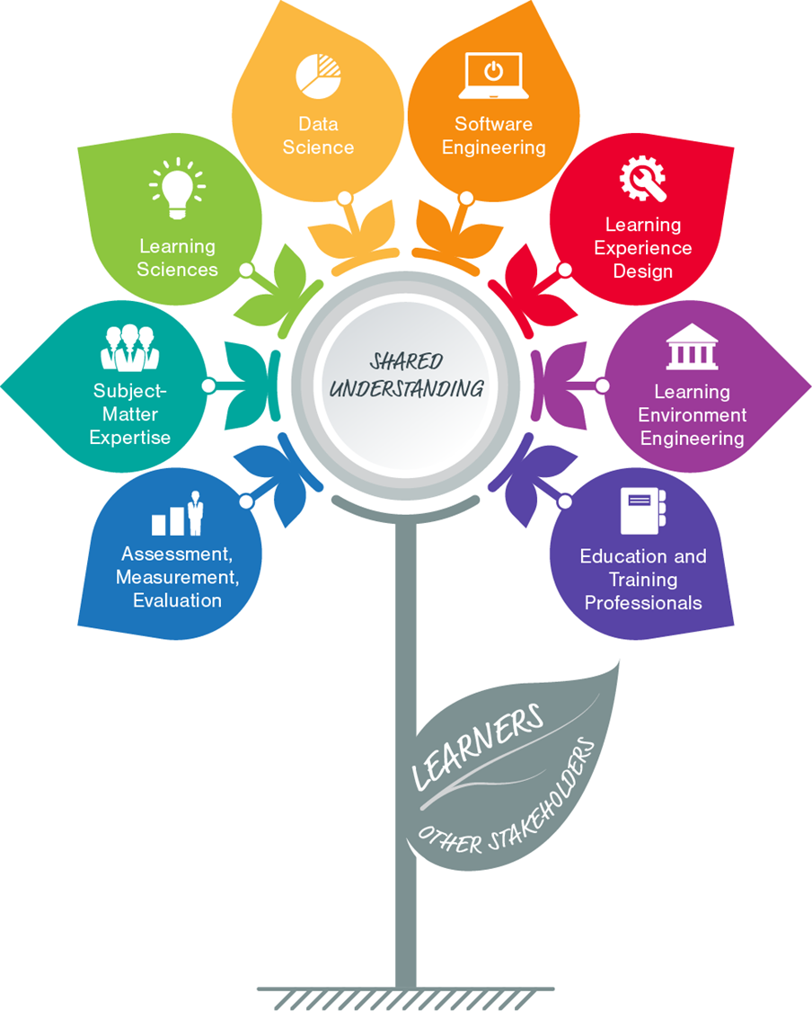
Here’s a popular graphic used by the Learning Engineering professional community
Learning Engineering isn’t “done to” learners and other stakeholders. It’s accomplished by, with, and through them.
Learners and stakeholders are part of the team!
CC-BY Jim Goodell
Notes:
Make sure to include learners and stakeholders on the team too!

Slide 30

learning engineering [ˈlərniNG ˌenjəˈniriNG]
Learning engineering is a process and practice that applies the
learning sciences, using human-centered engineering design methodologies and data-informed decision-making, to support learners and their development.
Notes:
Learning engineering is human-centered, that is:
Uses the principles of human centered design
Leverage specific tools from human-centered design fields (e.g., stakeholder analysis, personas, user testing)
Uses ethical decision-making for learning design

Slide 31

Before beginning to design, it’s important to understand the context:
Learning is situated. Understand the context, not only the learners and content but of the full system
Learners’ interests
Capabilities
Developmental stages
Probable prior knowledge
Everyday experiences
Support needs
Attitudes and beliefs
Time constraints
Learning environment
Faculty and mentor availability
Teachers’ capabilities
Social context
Technology availability
Digital literacy
Sometimes their living conditions
This is intentionally running off the page, because that’s a bit of a joke (i.e., there is a lot to consider)

Slide 32
It’s useful to envision the context as a human-centric system

Slide 33















Identity
Interests
Culture
Sensory Abilities
Mental
Models
Cognitive
Abilities
Experiences
Fatigue
start with the learner
Knowledge + Skills
Motivation
Notes:
Start with the learner, who has a wealth of personal capabilities, traits, and in-the-moment states.

Slide 34









INV vs. GROUP
OTHER TASKS
MODALITY
COMPLEXITY
TACTICS
TIME PRESSURE
consider the learner in combination with the learning activity
SUBJECT
COGNITIVE
REQUIREMENTS
INTERACTIVITY
Notes:
Then consider the context surrounding the learner and the learning activity

Slide 35












INV vs. GROUP
OTHER TASKS
MODALITY
SOCIAL
ENVIRONMENT
COMPLEXITY
TACTICS
HUMAN-TECH
INTERFACES
PHYSICAL
ENVIRONMENT
TIME PRESSURE
…as well as the context surrounding the learning experience
…and even all of this is situated within a larger context
SUBJECT
COGNITIVE
REQUIREMENTS
INTERACTIVITY
Notes:
But then you also need to consider the context surrounding the learner and the learning activity.
The physical environment:
Noise
Lighting
Temperature
Layout
Distractions
Accessibility
The social environment:
Authority gradients
Social climate
Psychological climate
Safety and wellbeing
Available mentors
Peer interactions
Interfaces
Classroom tools
IT Access
Internet Access
EdTech Options
User Interfaces
Accessibility features

Slide 36


DRAW TECHNIQUES FROM:
User-Centered Design
User Experience Design
Human-Systems Integration
Human Factors and Ergonomics
Design Thinking
Participatory Design
Design Justice
Universal Design For Learning
Learning Experience Design
Design-Based Research
Public Health
Conditions
Job
Market
Organizational
Processes
Organizational
Leadership
Faculty
Workload
All of this
combined leads to the performance, behaviors, and learning outcomes of the experience
Educational
Policies
Economic
Pressures
Resource
Availability
Government
Initiatives

Slide 37



Photo and project information courtesy of the World Bank
Notes:
Storytime: How donkey carts helped advance education in Gambia.
PHOTO: https://blogs.worldbank.org/education/how-donkey-school-buses-benefit-early-grade-children-gambia
Learning engineers design learning experiences, but that’s not all they do. They also address the contexts and conditions that lead to great learning. These might include the architecture of physical or virtual learning environments, social structures, and learners’ mindsets as well as more obvious targets such as curriculum design, educational technology, and learning analytics.
In the West African country of Gambia, the problem to be solved was student access to local schools. “In a concerted effort to reduce inequity, the government abolished school fees and increased the number of communities that have schools within three kilometers from 83 percent in 2013 to 95 percent in 2018,” according to a story posted to the World Bank website. However, nearly 30 percent of school-aged children still didn’t attend classes. A problem was that a three kilometer walk to school was too far for three- to eight year-old students. Parents were concerned about their children’s safety over the long
distances.
The problem was framed by the context of poorly developed or nonexistent roads. “Donkeys, a common means of transport in The Gambia, were a natural, yet innovative, choice,” according to the World Bank article, “and different communities across the country were enthusiastic about the idea.” Donkey carts were engineered to carry ten young children each and could be driven by an older student.
A key strategy in any engineering design is iterative improvement. The low-tech donkey cart solution used an iterative process. “An initial pilot revealed that while the original carts were an effective means to transport children to school, these were too heavy and needed to be redesigned. As a result, a lighter 2.0 model of the cart was launched in 2015. Built with locally sourced materials, the revamped carts handle more easily, have a seat for each child, and incorporate important safety features such as a gate and easy-to-grab handles.”

Slide 38

learning engineering [ˈlərniNG ˌenjəˈniriNG]
Learning engineering is a process and practice that applies the
learning sciences, using human-centered engineering design methodologies and data-informed decision-making, to support learners and their development.

Slide 39


Applied, ecological discipline
Education
A body of knowledge
Anthropology
…about…
Neuroscience
How people learn and how to enhance learning
Year: 1990
is
Design Science
Interdisciplinary field, including…
…derived from…
Cognitive Science
Human cognition and learning
Scientific Research
Formally Established
Computer Science
Applied Linguistics
(linked together)
on
Continuously improve instructional methods
Education theory and practice
is not
Goals
Create and discover learning innovations
Just anecdote and tradition
Apply it to create effective, efficient, and affordable learning
Focused on isolated parts of the instructional system
Expecting “perfect” one-and-done solutions
Where?
Areas of study
Formal schools
Online / distributed
The way people learn
Factors that affect learning
Instructional methods to enhance learning
Technology to facilitate learning
Methods to evaluate learning objectives
On the job
Informal settings
(basically anywhere)

Slide 40

learning engineering [ˈlərniNG ˌenjəˈniriNG]
Learning engineering is a process and practice that applies the
learning sciences, using human-centered engineering design methodologies and data-informed decision-making, to support learners and their development.

Slide 42



Slide 43
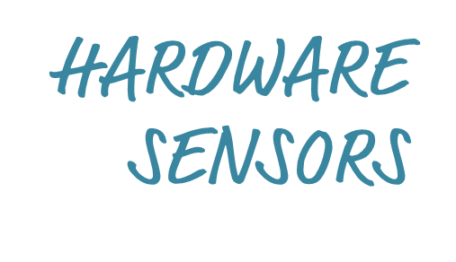



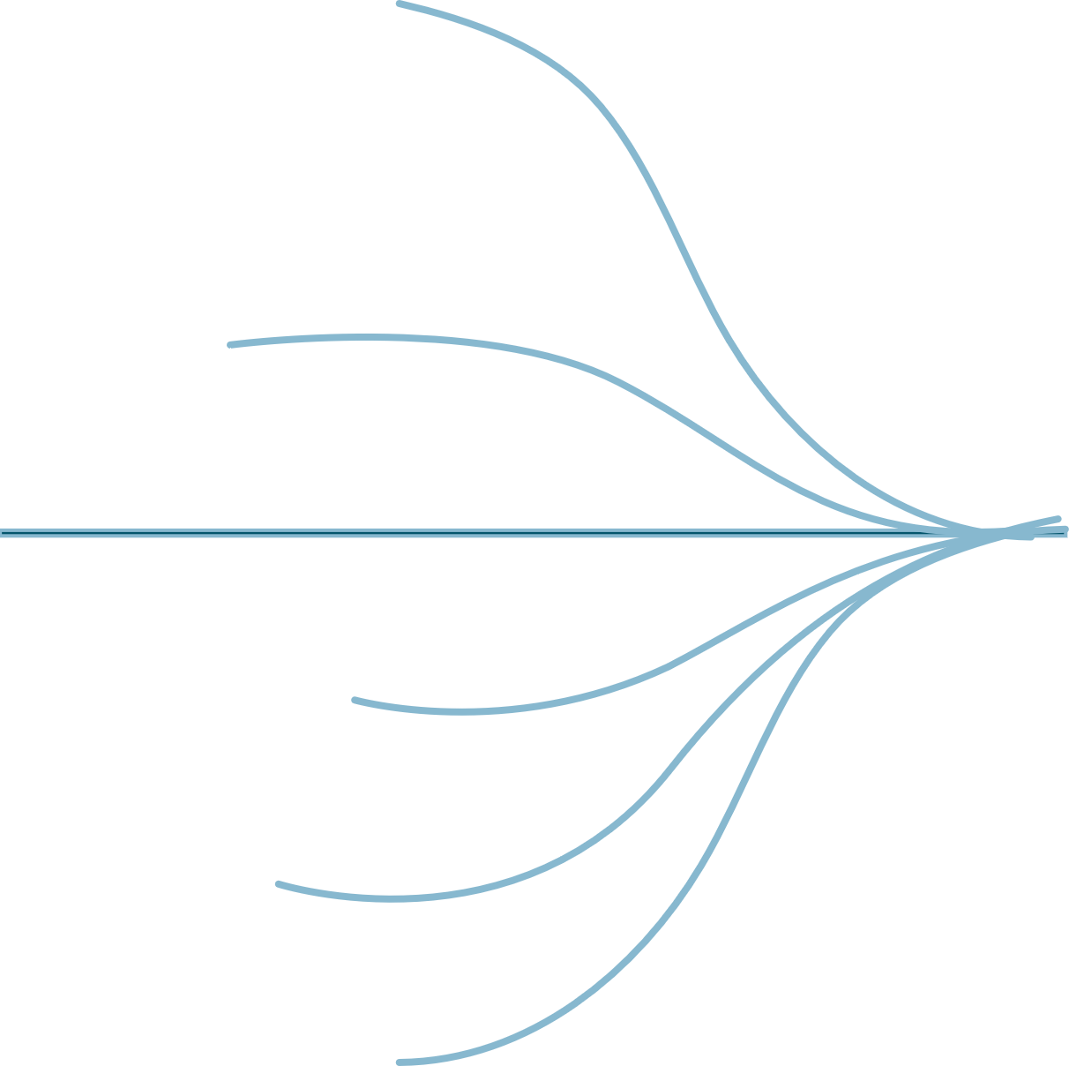
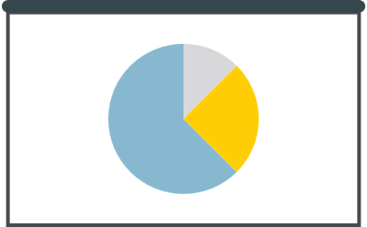



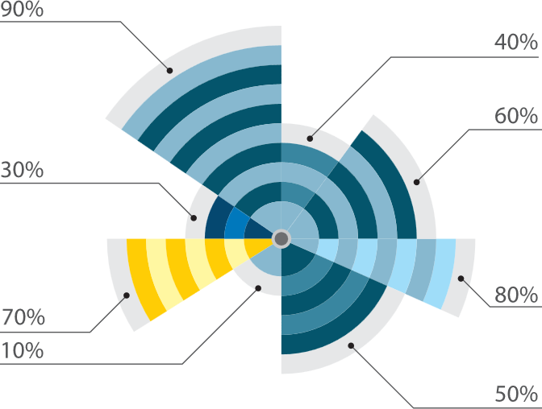





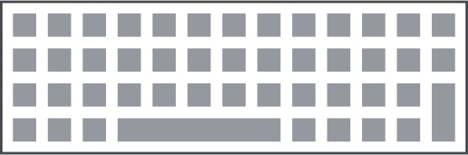
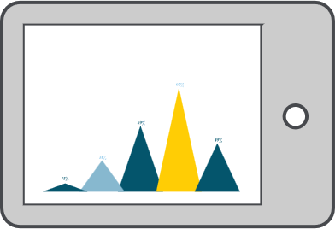

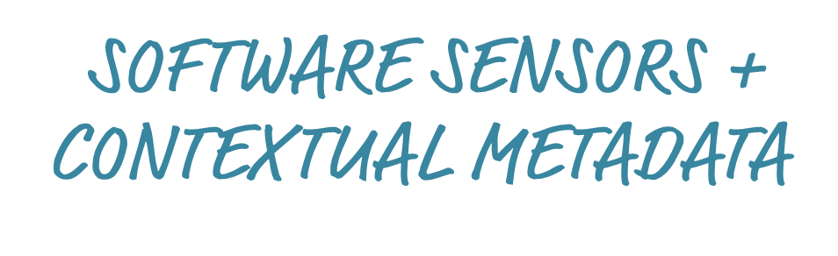
Who
What Action
What Activity
What Context
What Result
xAPI
xAPI
xAPI
xAPI
xAPI
xAPI
xAPI
Notes:
Sensors and their data pipelines have limits and require trade-offs.

Slide 44
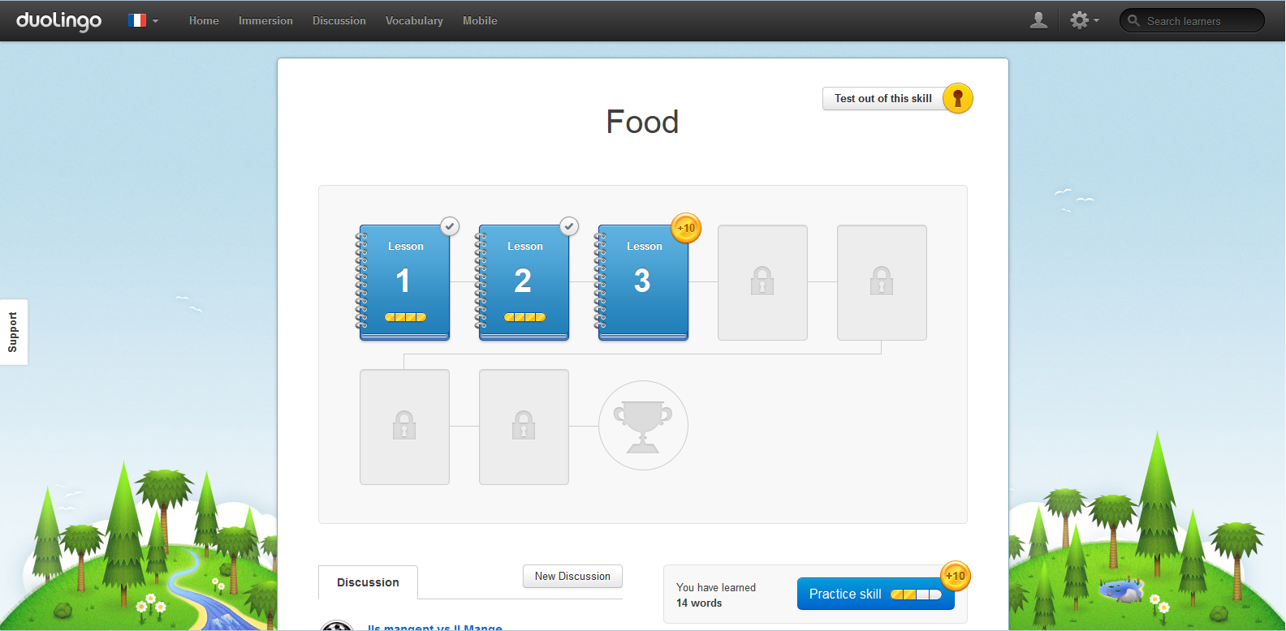
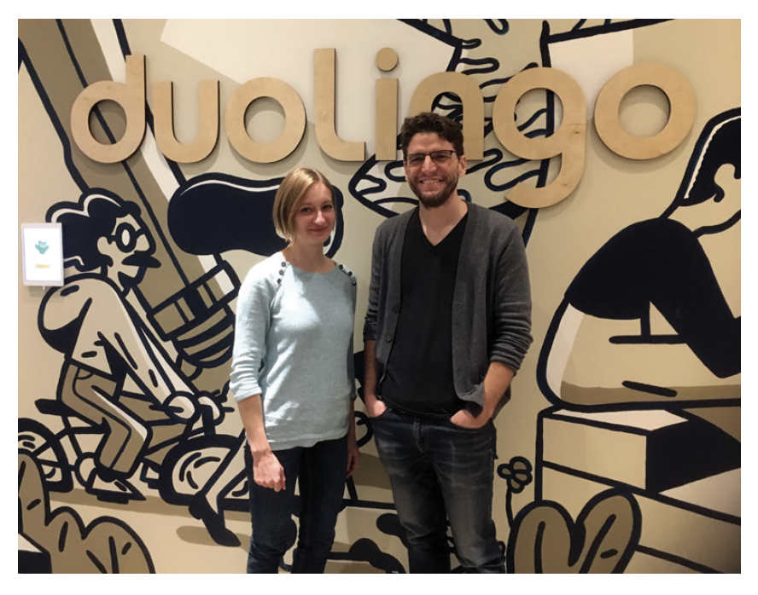
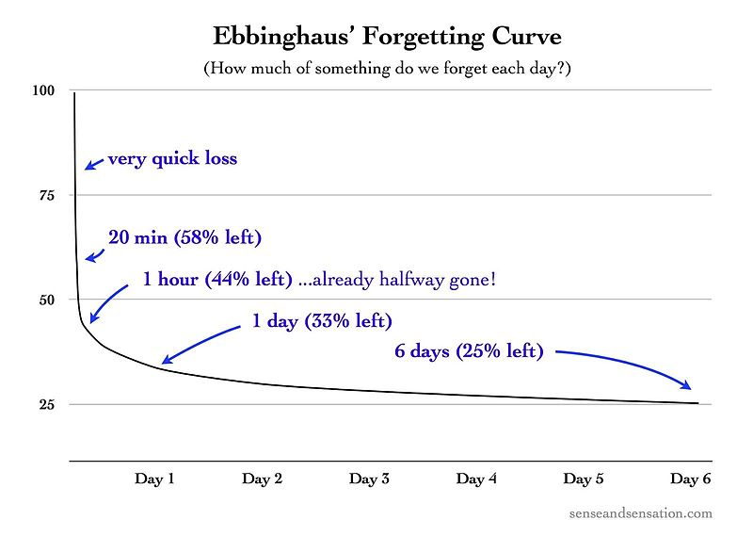

EXAMPLE Learning Analytics to Optimize Spaced Repetition
Notes:
A great example of automated learning analytics used to apply learning science is what happens within the language learning app Duolingo. In 1879 German psychologist Hermann Ebbinghaus pioneered what we know about learning curves, how fast people learn new facts, and forgetting curves, how fast people forget what they’ve learned. More recent research indicates that an efficient time to practice knowledge retrieval is right before forgetting it. Duolingo applies this learning science finding using big data analytics to predict when a learner is about to forget a word. Burr Settles co-developed the trainable spaced repetition model that uses machine learning and data from millions of learners to make personal predictions about the best time for each learner to do retrieval practice for each word in their new vocabulary.

Slide 45
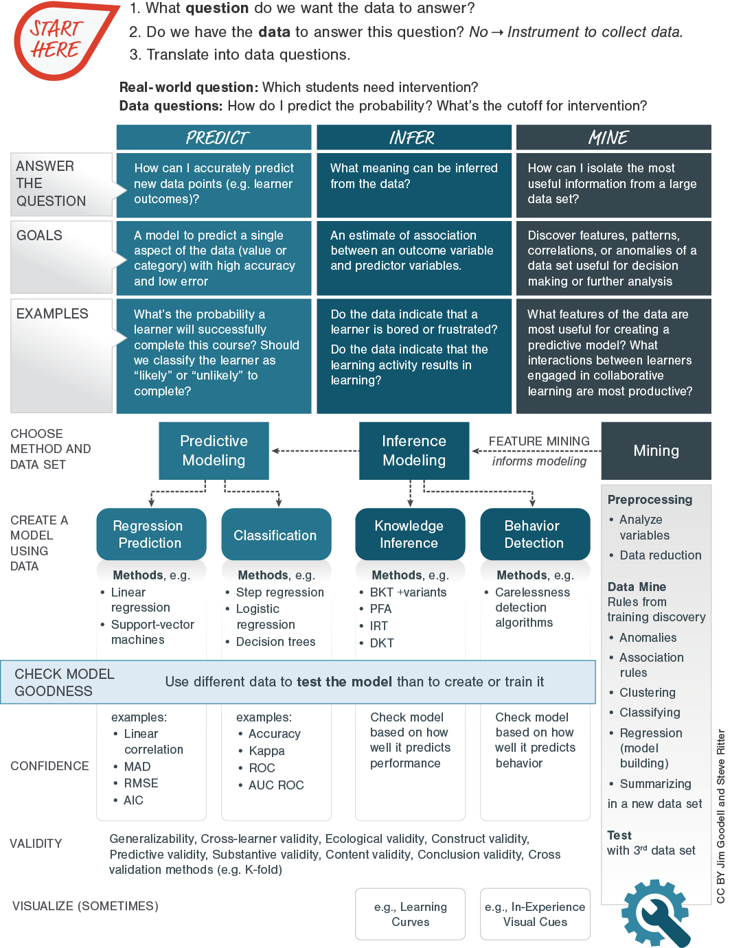
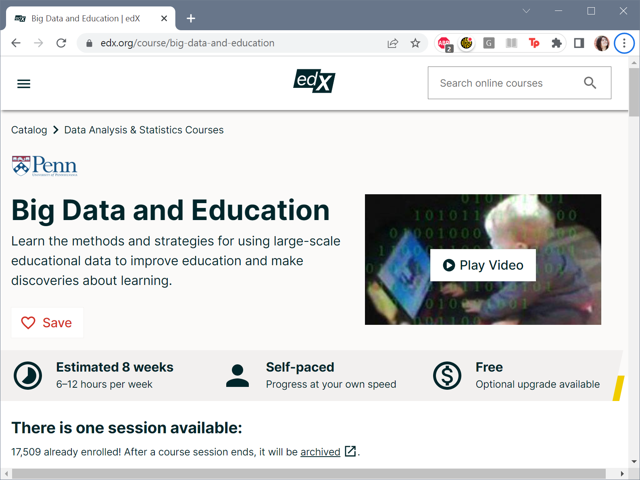
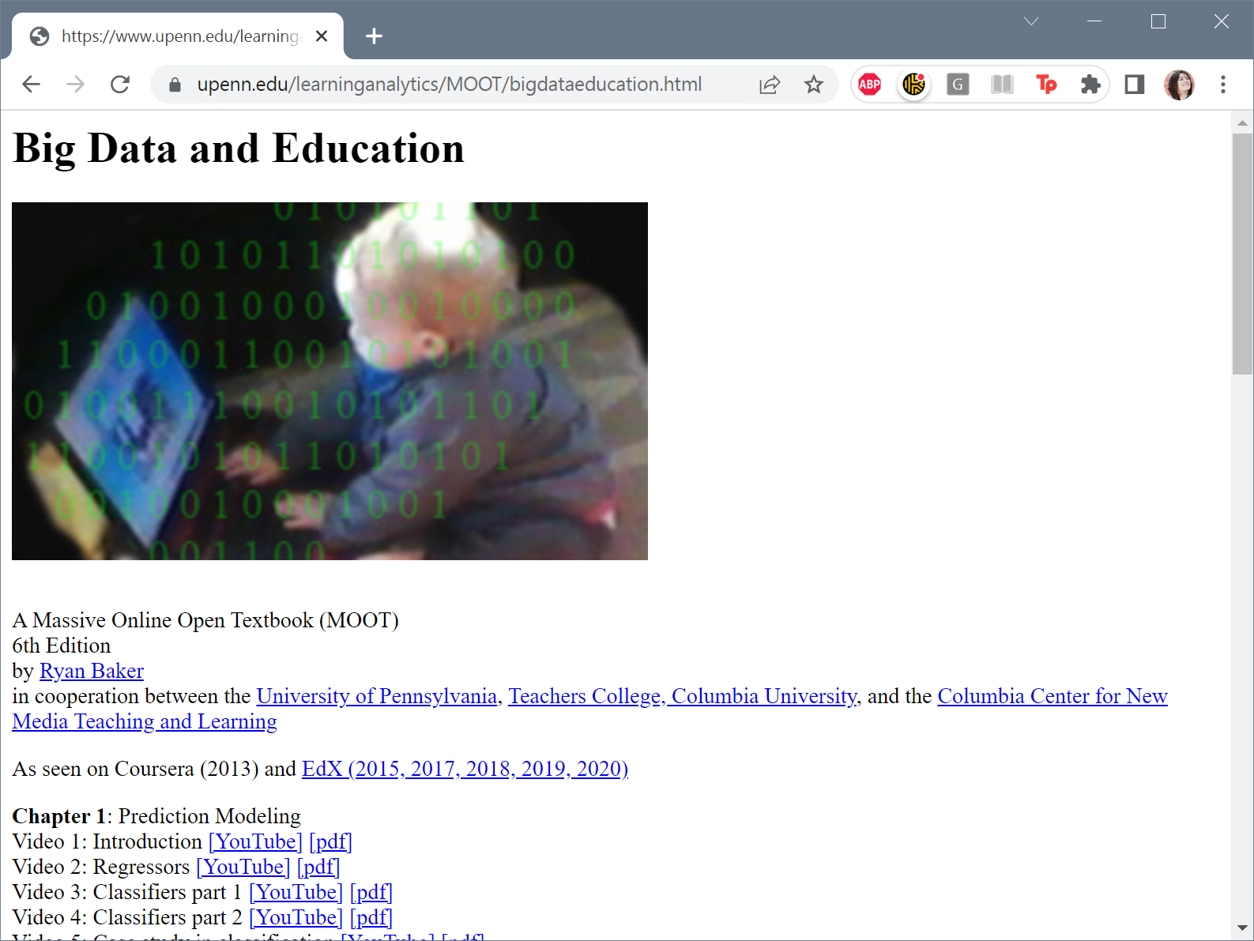
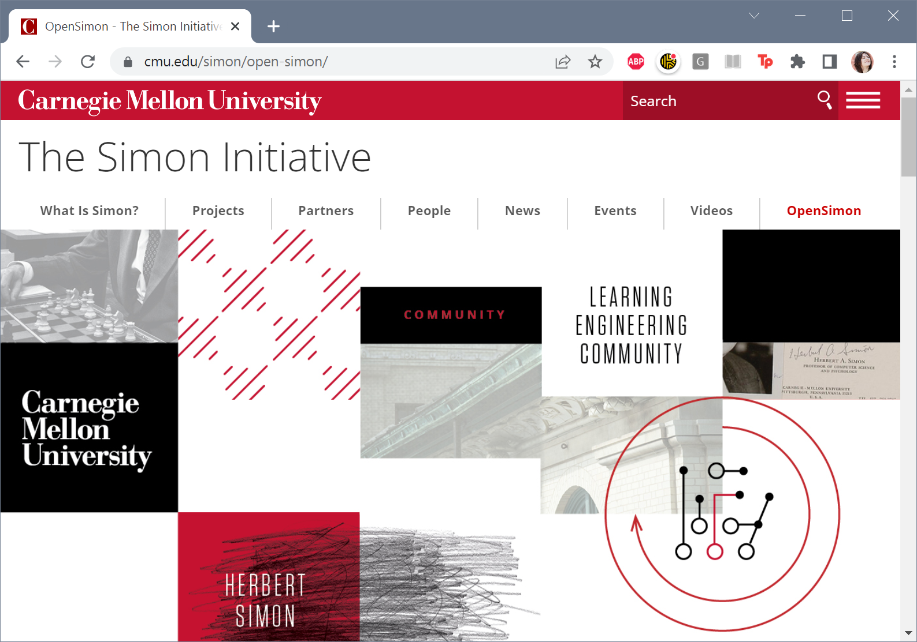


Slide 46


Slide 47



Learning engineering is a process
Focused on outcomes that involve learning
…but using a wide variety of tools, including (but not only) the learning sciences
Learning engineering is human-centered
Learning engineering is also data-centered
ISSUES BEYOND CURRICULUM
LEVERAGE MODERN TOOLS
SCALE QUALITY
Notes:
End/Q&A
Brief summary of key points
Where to find more information
Open Q&A

Slide 48
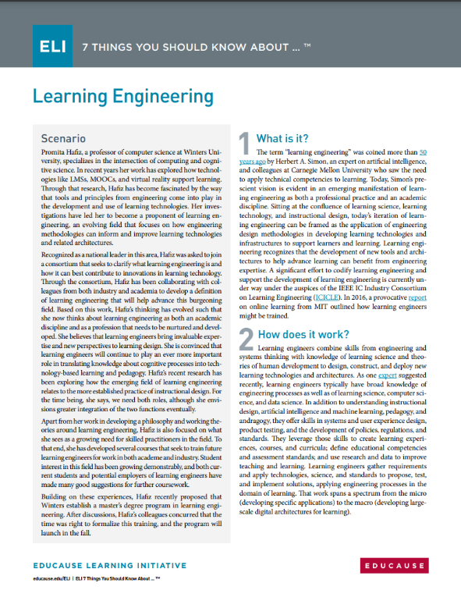
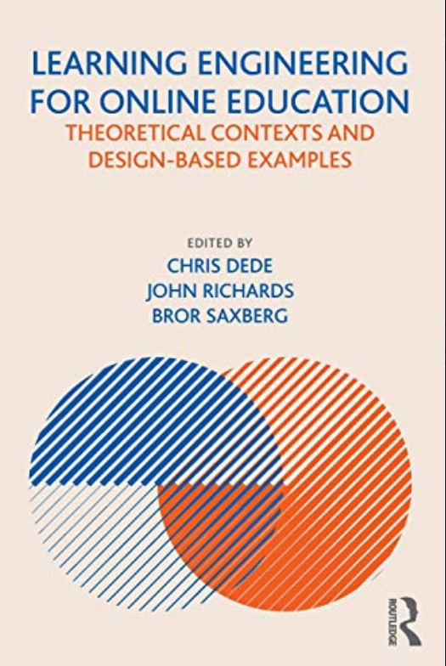
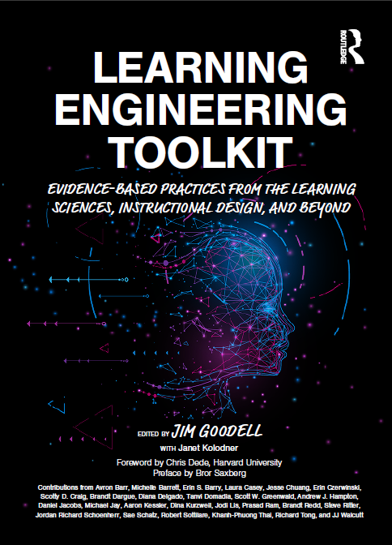

Useful References
7 Things You Should Know About Learning Engineering
Educause Learning Initiative
Learning Engineering for Online Education
By Chris Dede, John Richards, Bror Saxberg
Learning Engineering Toolkit
Edited by Jim Goodell
with Janet Kolodner
IEEE IC Industry Consortium on Learning Engineering
http://ieeeicicle.org
Notes:
See also ICICLE Online Community
For Learning Engineering Practitioners (Discord Server)
https://discord.gg/jhZpUfa4FR

Slide 49


Useful References
are we done yet?
7 Things You Should Know About Learning Engineering
Educause Learning Initiative
Learning Engineering for Online Education
By Chris Dede, John Richards, Bror Saxberg
Learning Engineering Toolkit
Edited by Jim Goodell
with Janet Kolodner
IEEE IC Industry Consortium on Learning Engineering
http://ieeeicicle.org
EdTech and Researcher Google Community https://groups.google.
com/g/learning-engineering
Notes:
See also ICICLE Online Community
For Learning Engineering Practitioners (Discord Server)
https://discord.gg/jhZpUfa4FR
IEEE ICICLE is a volunteer professional organization committed to the development of Learning Engineering as a profession and as an academic discipline. It facilitates in-person and virtual conferences, special interest groups and market interest groups.
The ICICLE Online Community Discord Server is an asynchronous community facilitated by members of ICICLE hosting ongoing dialog, free professional learning resources, and support for learning engineering teams. It’s a community where practitioners can help practitioners learn about and advance the profession of learning engineering.
The Google group has specific focus on: First to attract top talent from technical fields to learning science and learning engineering.
Second, the rise of large digital platforms creates the opportunity for researchers to conduct well-designed, large, rapid experiments, which remain rare in education research today.

Slide 50
Let’s test ourselves…
…explain the purpose, scope, and characteristics of learning engineering
…compare and contrast learning engineering to other disciplines (e.g., learning science)
…help organize a team for and execute a learning engineering process for a real-world project
…fish for myself (find resources to continue to improve my learning engineering capabilities)
Notes:
Define the purpose, scope, and distinct characteristics of the learning engineering field.
Explain the benefits of learning engineering (over and above subordinate or related fields).
Design a learning engineering team and process for a practical training/education goal.
Explain how to find additional learning engineering information for practical applications.
MORE: Look smart in front of your boss and colleagues, when you know how to explain how all of the pieces of pedagogy, cognition, technology, data, and organizational design fit together. You’ll be one of the first to know about this hot new emerging discipline!

Slide 51



Slide 52
Learner
Instructor
What does my “skill map” look like?
How many “points” (activities, engagements, etc.) do I need to complete “this,” move to the next level, or unlock an achievement?
What competencies haven’t I exercised lately?
How do I rank against my peers?
How much more time do I have to spend to complete “this”?
How much time do I spend doing various activities, and how could this be optimized?
What new learning topics should I consider, based upon my history and characteristics?
How are learners performing overall in terms of scores and progress to completion?
When was the last time I interacted with each learner or team?
What were learners’ satisfaction ratings for different courses or activities? And which of these were rated best or worst?
What questions or instructional units do people routinely all pass or routinely all fail?
What are learners’ engagement levels, and which have not engaged recently?
Are my learners on track, ahead, or behind?

Slide 53


Learning Analytics Process Model
1. What question do we want the data to answer?
2. Do we have the data to answer this question?
No = Instrument to collect data
3. Translate into data questions.
Real-world question: Which students need intervention?
Data questions: How do I predict the probability? What’s the cutoff for intervention?
Notes:
In the Learning Engineering Toolkit we have a learning analytics process model. It’s a kind of recipe for doing common kinds of learning analytics. The process starts with identifying what question we want the data to answer? [click]
Then we ask, “do we have the data to answer the question?” If not, we need to develop instrumentation to collect the data. If we think we have the data. [click]
Next we need to translate the operational question into a data question.
If the operational question is which learners need intervention. The data question might be “How do we predict the probability that an intervention will benefit a person’s learning?” Another data question is, once we have predictions where do we draw the line on giving the intervention? 50%, 60% 80% chance of benefit? Are there resource constraints that need to be factored into that cut-off? Here’s were engineering principles are needed. The decision is not theoretical. There are resource constraints that must be considered. [click]

Slide 54



Answer
the Question
How can I accurately predict new data points (e.g. learner outcomes)?
What meaning can be inferred from the data?
How can I isolate the most useful information from a large data set?
Goals
A model to predict a single aspect of the data (value or category) with high accuracy and low error
An estimate of association between an outcome variable and predictor variables.
Discover features, patterns, correlations, or anomalies of a data set useful for decision making or further analysis
Examples
What’s the probability a learner will successfully complete this course? Should we classify the learner as “likely” or “unlikely” to complete?
Do the data indicate that a learner is bored or frustrated?
Do the data indicate that the learning activity results in learning?
What features of the data are most useful for creating a predictive model? What interactions between learners engaged in collaborative learning are most productive?
Notes:
In the Learning Engineering Toolkit we have a learning analytics process model. It’s a kind of recipe for doing common kinds of learning analytics. The process starts with identifying what question we want the data to answer? [click]
Then we ask, “do we have the data to answer the question?” If not, we need to develop instrumentation to collect the data. If we think we have the data. [click]
Next we need to translate the operational question into a data question.
If the operational question is which learners need intervention. The data question might be “How do we predict the probability that an intervention will benefit a person’s learning?” Another data question is, once we have predictions where do we draw the line on giving the intervention? 50%, 60% 80% chance of benefit? Are there resource constraints that need to be factored into that cut-off? Here’s were engineering principles are needed. The decision is not theoretical. There are resource constraints that must be considered. [click]

Slide 55
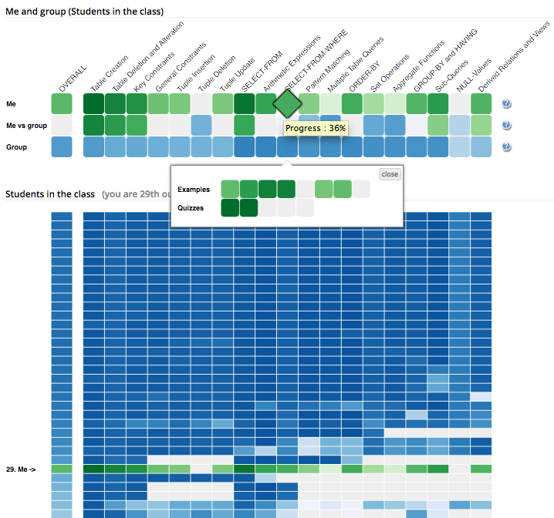
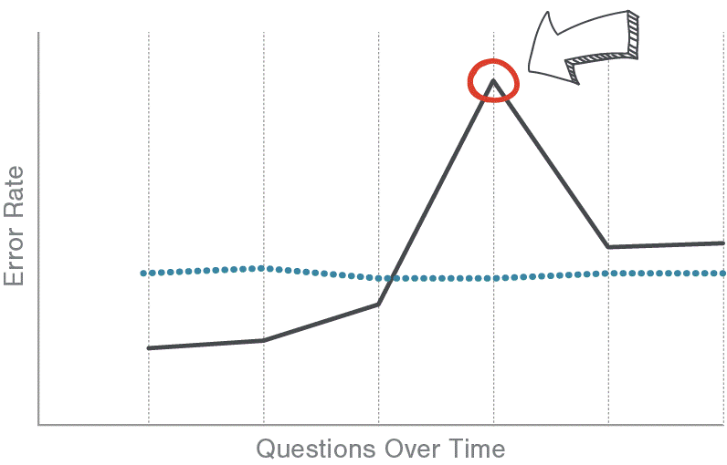
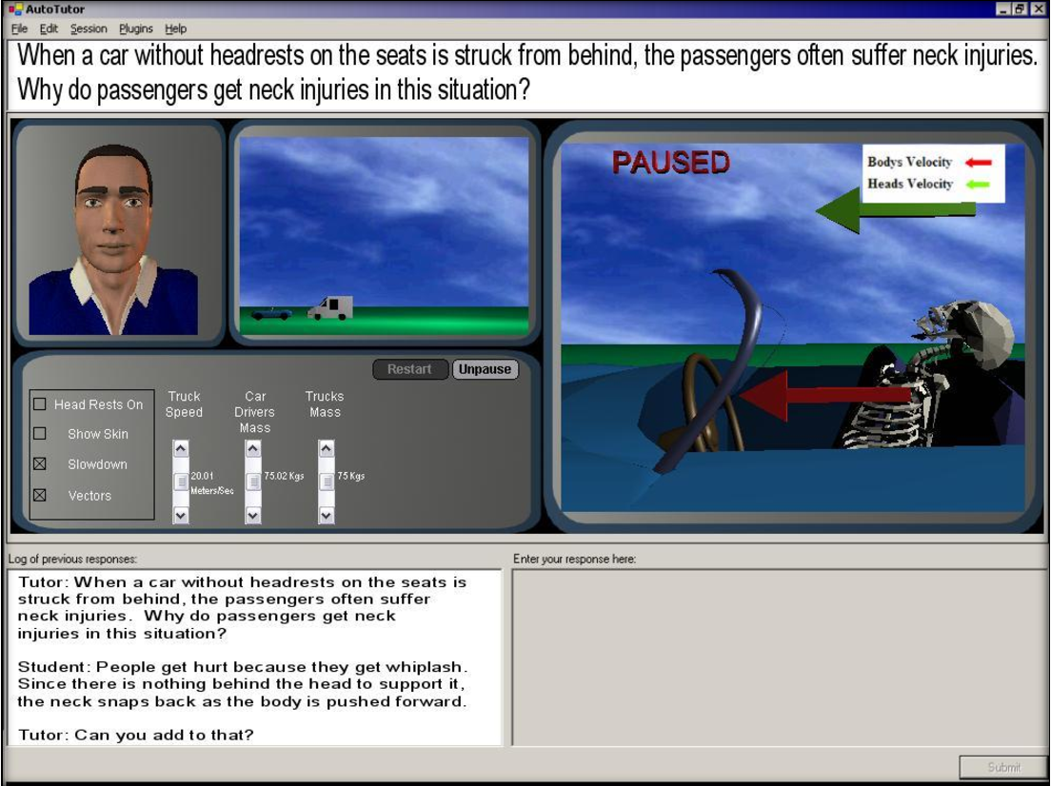

Choose method and data set
Predictive Modeling
Inference Modeling
Feature Mining
informs modeling
Mining
Preprocessing
• Analyze variables
• Data reduction
Data Mine
Rules from training discovery
• Anomalies
• Association rules
• Clustering
• Classifying
• Regression (model building)
• Summarizing
…in a new data set
Test
with 3rd data set
Create a model using data
Regression Prediction
Classification
Knowledge Inference
Behavior Detection
Methods, e.g.
• BKT +variants
• PFA
• IRT
• DKT
Check model
goodness
Methods, e.g.
• Step regression
• Logistic regression
• Decision trees
Methods, e.g.
• Carelessness detection algorithms
Use different data to test the model than to create or train it
Methods, e.g.
• Linear regression
• Support-vector machines
examples:
• Linear correlation
• MAD
• RMSE
• AIC
examples:
• Accuracy
• Kappa
• ROC
• AUC ROC
Check model based on how well it predicts performance
Check model based on how well it predicts behavior
Confidence
Confidence
Generalizability, Cross-learner validity, Ecological validity, Construct validity, Predictive validity, Substantive validity, Content validity, Conclusion validity, Cross validation methods (e.g. K-fold)
Visualize (sometimes)
Notes:
Once we have data questions, we can determine what type of analysis is needed. In our example, we might want to choose an analysis method to predict the probability that a learner will benefit from the intervention (the output is a single number). Or we can use that probability with a classification method that’s sets thresholds and determines which learners should get the intervention and which should not. [click]
For each type of data question there are applicable models and methods.

Slide 56
Human-Centered Design
Human-Centered Design
Notes:
+ Here is a list of some field that provide tools for human-centered design

Slide 57
Human-Centered Design
Discover: Read the literature, observe, and conduct interviews
Ideate: Brainstorm about the challenge through the lens of that research
Feedback: Rapidly prototype and get feedback from learners and other stakeholders
Testing: Conduct user testing with the prototype in realistic contexts
Iterate: Redesign the concepts and prototype based on feedback and testing
Mature: Iteratively advance the prototype into more sophisticated forms and repeat
Notes:
+ Here is a list of some field that provide tools for human-centered design

Slide 58
Human-Centered Design
Discover: Read the literature, observe, and conduct interviews
Ideate: Brainstorm about the challenge through the lens of that research
Feedback: Rapidly prototype and get feedback from learners and other stakeholders
Testing: Conduct user testing with the prototype in realistic contexts
Iterate: Redesign the concepts and prototype based on feedback and testing
Mature: Iteratively advance the prototype into more sophisticated forms and repeat
Notes:
+ Here is a list of some field that provide tools for human-centered design

Slide 59


EXAMPLE » Discover » Human Research Methods
Stakeholder elicitation, such as interviews or focus groups
Open-ended reactions or attitudinal surveys
Behavioral or cognitive task analyses
Field observation, ethnography, and participatory analyses
Design-based research (although this can also be quantitative)
Reviews of published case studies
Trend analyses
Quantitative analyses of published studies, like meta-analyses
Likert-style questionnaires with close-ended answer options
Computational methods, like modeling and simulation
Experimental and quasi-experimental studies
Notes:
Start with qual and quant research methods

Slide 60
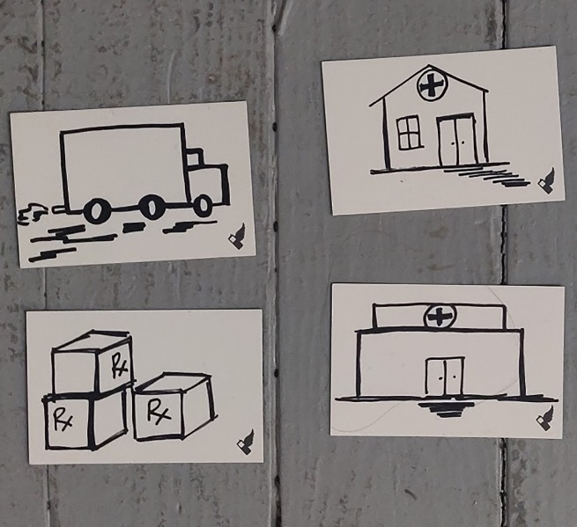
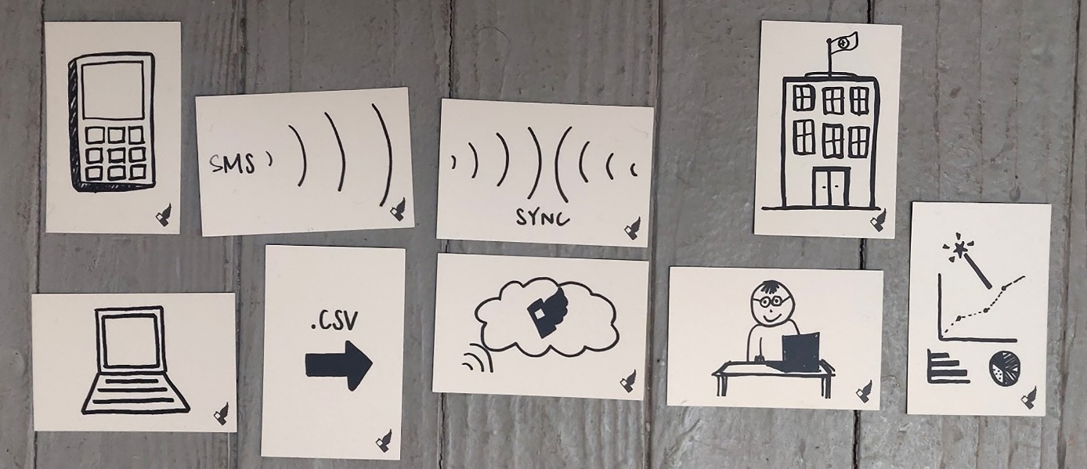




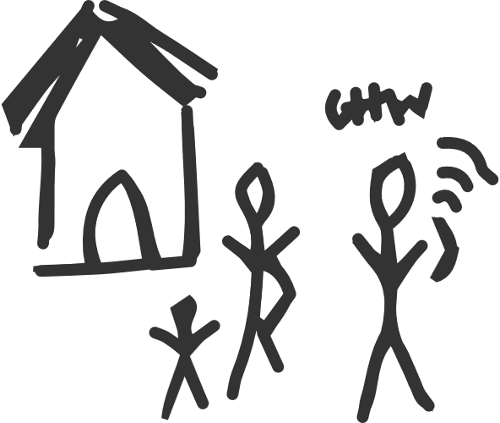


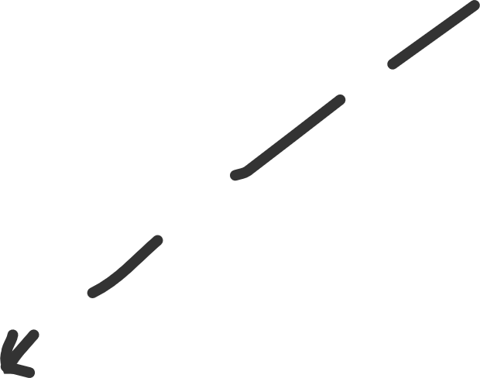





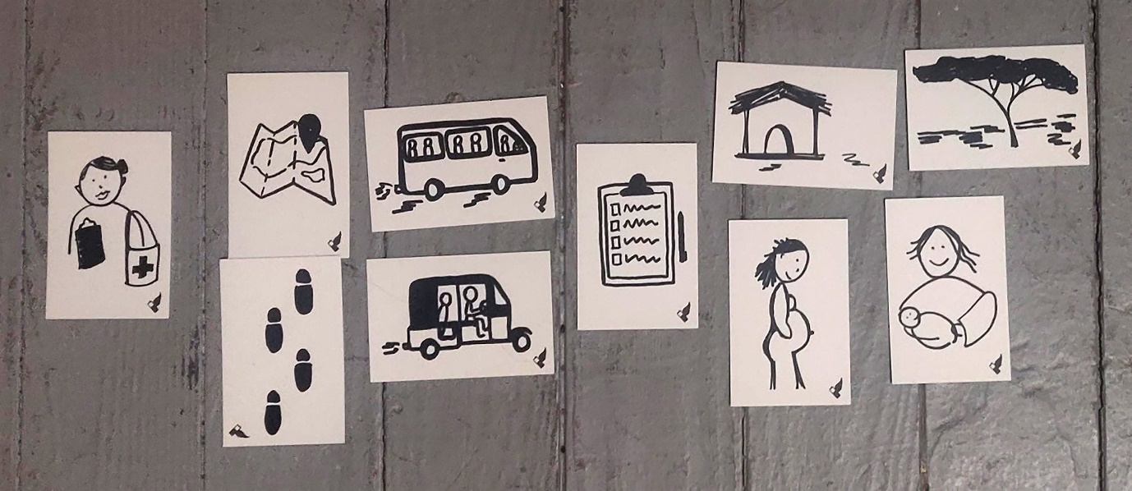






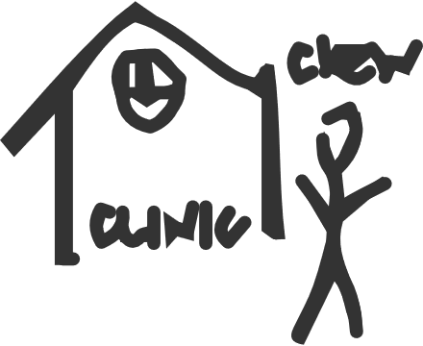



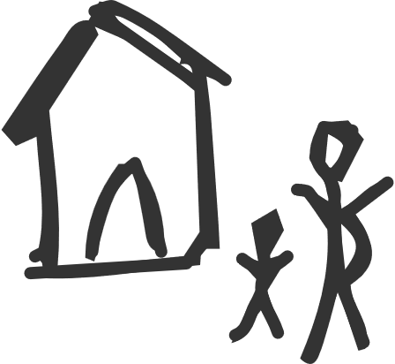




EXAMPLE » Discover » Design Cards
Images and project courtesy of Medic Mobile and Khanh-Phuong Thai, Scotty D. Craig, Jim Goodell, Jodi Lis, Jordan Richard Schoenherr, and Janet Kolodner
Notes:
Design cards are cards that each depict a single concept via text or imagery. Design cards can be used in various ways to guide collaborative idea generation and critique, prompt the team to consider the wider spectrum of key issues, or help participants sequence or prioritize concepts, such as for modeling of workflows or processes. And the value of design cards doesn’t end with the initial design phase. For instance, they can be used as cues to help stakeholders critique aspects of a design in support of development iterations. Using a set of learning sciences concept cards might help end users respond to various questions about the prototype design, such as “How well did we do in addressing this aspect of learning?”
A set of cards typically covers a comprehensive topic, but beyond that, there’s much variation. A set may reference more generalizable concepts (such as instructional tactics) using text, or it might include personalized images created for a specific context. For these cards, by using the cards during participatory design workshops, stakeholders were better able to conceptualize the wider system, engage in detailed discussions about the health care workflow, and share stories from their own experiences.
The graphics above show a real-world example of using design cards to create the Medic Mobile training app for rural medial providers.

Slide 61
Human-Centered Design
Discover: Read the literature, observe, and conduct interviews
Ideate: Brainstorm about the challenge through the lens of that research
Feedback: Rapidly prototype and get feedback from learners and other stakeholders
Testing: Conduct user testing with the prototype in realistic contexts
Iterate: Redesign the concepts and prototype based on feedback and testing
Mature: Iteratively advance the prototype into more sophisticated forms and repeat

Slide 62



EXAMPLE » Ideate » Personas
Include a name, image, and possible behaviors, goals, interests, and frustrations—all as learned through data collection
Create a persona for each of the major subgroups of potential users who will interact with the design being created
Build personas from the data you collected during the discovery phase.
Notes:
Include a name, photo or sketch, and possible behaviors, goals, interests, and frustrations—all as learned through data collection.
A persona is a description of a subgroup of people who will interact with one’s designs or some representative of that subgroup. In other words, a persona is a description of a fictitious user or learner. One persona is created for each of the major subgroups of potential users who will interact with the design being created. When designing for learners and learning, this means creating one to represent each of the major variations across members of the targeted learner population.
The set of personas is used during design to decide which of several options will work better and to guide adaption so that those options work more broadly. Personas are used during critique, to predict how broadly a design will work, and they’re used during testing to identify those subpopulations with whom a design should be tested.
Personas are developed using data that are collected before design begins, during the investigative empathy stage. Personas may be the most important resources created for guiding design: The best designs take personas into account during ideation, critiquing and idea refinement, and development of test procedures.
Included in each persona is a name, photo or sketch, and possible behaviors, goals, interests, and frustrations—all as learned through data collection. The design justice approach emphasizes that personas should be created based on the lived experiences of end users (learners in our case) and other stakeholders and not just on

Slide 63
EXAMPLE » Ideate » Personas
Lawrence
Retired Air Force O5
Has a background in this topic
Eager to learn
Loves learning online
Is eager to learn more about this topic
Is frustrated by not knowing more about this topic
Notes:
Don’t just create caricatures of “perfect” or one dimensional learners.
Who are my learners, and what will they learn?
What are my learners’ different interests related to what they’ll learn?
Why would these learners want to learn the targeted skills and content?
Given that, how might they become engaged in learning?
What prior knowledge and experiences do they bring with them?
What range of abilities do different learners possess?
When and where will they learn?
How do they engage in this environment?
How do they see themselves in this environment? How do they identify?
How might we design learning activities that connect to varying identities?
How might we ensure learners’ equitable access and empowerment?

Slide 64


EXAMPLE » Ideate » Personas
Lawrence
Retired Air Force O5
Has 5 years prior experience in the topic, but from 7 years ago
Hand-eye mobility is sometimes imprecise
Is interested in learning but is distracted by work and family
Sometimes accesses content from low-bandwidth systems
Frustrated by having to read long and complicated DoD manuals to troubleshoot processes at his job and would like to have easier-to-find just-in-time information sources
Notes:
Don’t just create caricatures of “perfect” or one dimensional learners.
Who are my learners, and what will they learn?
What are my learners’ different interests related to what they’ll learn?
Why would these learners want to learn the targeted skills and content?
Given that, how might they become engaged in learning?
What prior knowledge and experiences do they bring with them?
What range of abilities do different learners possess?
When and where will they learn?
How do they engage in this environment?
How do they see themselves in this environment? How do they identify?
How might we design learning activities that connect to varying identities?
How might we ensure learners’ equitable access and empowerment?

Slide 65
EXAMPLE » Ideate
Scenarios
Use Cases
User Stories
Stakeholder analyses
Logic models
Conjecture diagrams
Theory of change
…and so on
Notes:
There are many great resources from the human-centered design fields to help with this.
+ Many free resources and ideas from Ideo.

Slide 66
Human-Centered Design
Discover: Read the literature, observe, and conduct interviews
Ideate: Brainstorm about the challenge through the lens of that research
Feedback: Rapidly prototype and get feedback from learners and other stakeholders
Testing: Conduct user testing with the prototype in realistic contexts
Iterate: Redesign the concepts and prototype based on feedback and testing
Mature: Iteratively advance the prototype into more sophisticated forms and repeat

Slide 67
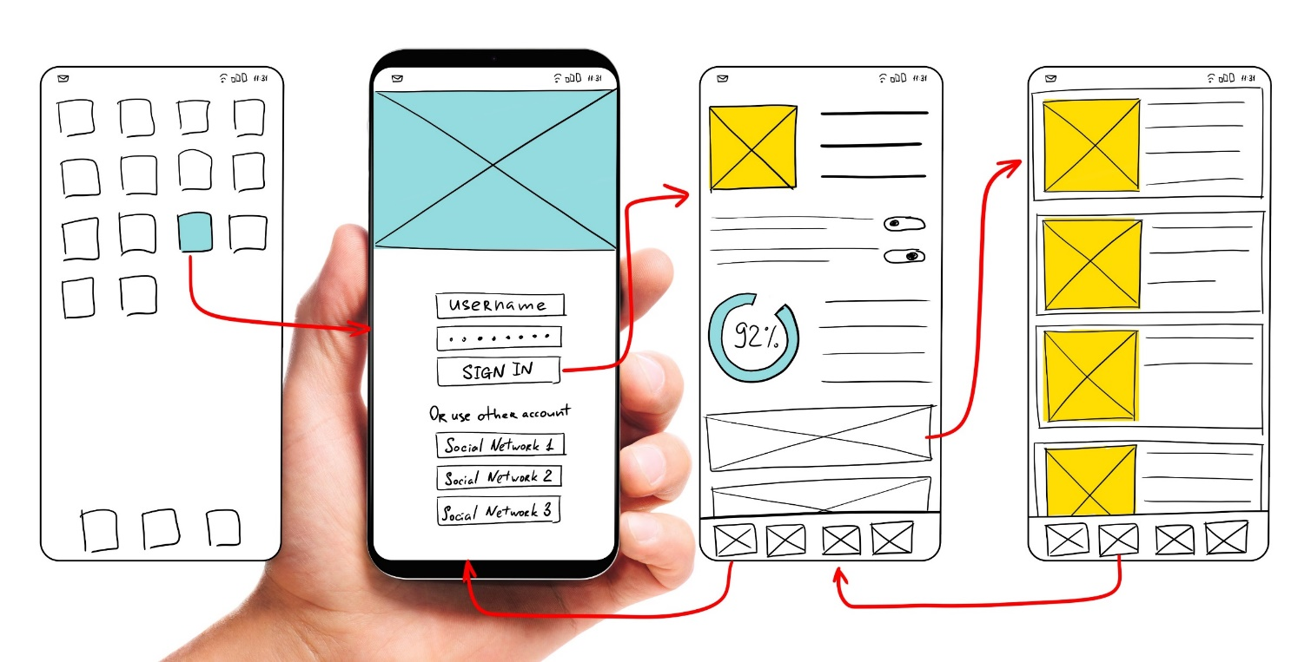
EXAMPLE » Prototype
Notes:
Prototype early and often. Make bad, quick, paper-based prototypes first and then mature from there. Don’t wait until you have a “perfect” mockup to share it with stakeholders for feedback.

Slide 68
Human-Centered Design
Discover: Read the literature, observe, and conduct interviews
Ideate: Brainstorm about the challenge through the lens of that research
Feedback: Rapidly prototype and get feedback from learners and other stakeholders
Testing: Conduct user testing with the prototype in realistic contexts
Iterate: Redesign the concepts and prototype based on feedback and testing
Mature: Iteratively advance the prototype into more sophisticated forms and repeat

Slide 69
EXAMPLE » Test » Traditional (Kirkpatrick’s Hierarchy)
1. Reactions: What did learners think? Did they enjoy the experience?
2. Learning: What did they learn? (Usually a pre / post-test combination)
3. Behavior: Did the experience affect future behaviors, like job activities?
4. Results: Was there a noticeable impact, like a company’s performance?
Notes:
Of course, there’s the traditional way of doing testing… this is good and necessary.

Slide 70

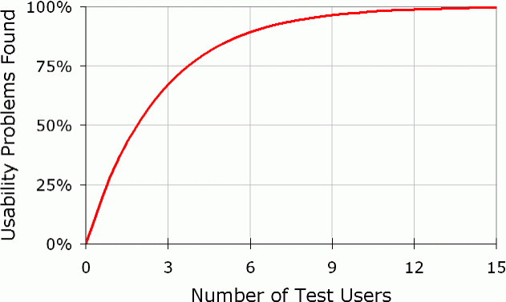
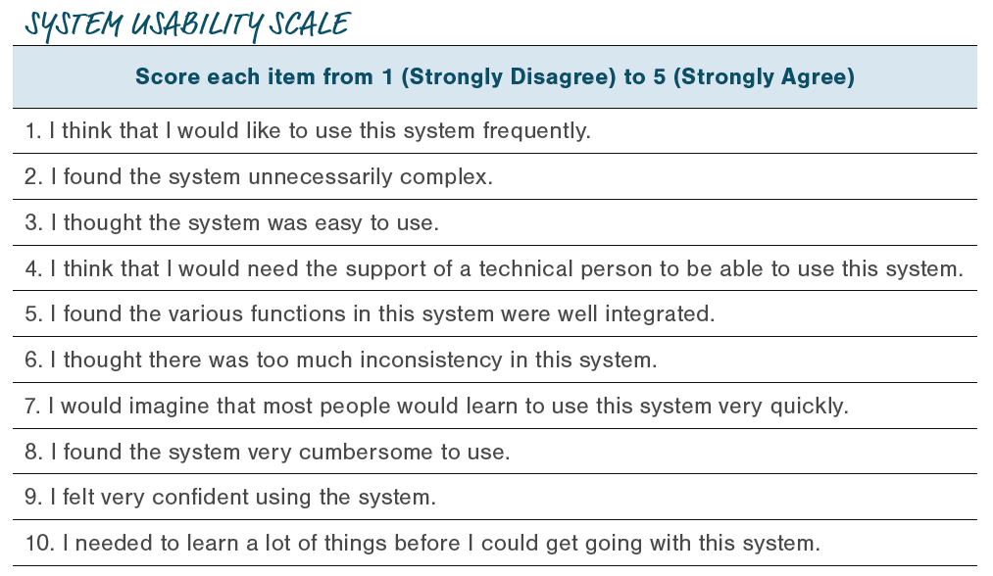
EXAMPLE » Test » Usability and User Experience
Some people think that . . . user tests should be reserved for the rare web design project with a huge budget and a lavish time schedule. Not true. Elaborate usability tests are a waste of resources. The best results come from testing no more than five users and running as many small tests as you can afford.
The most striking truth . . . is that zero users give zero insights.
Notes:
Make sure to also include UI/UX testing. Usability testing is one particular kind of end-user testing. It involves testing a product with representative end users to examine its human-system interface in order to identify problems in the design of the solution, uncover opportunities to improve or add features, and learn about the target population’s behavior and preferences. Remember that witty advice from Jakob Nielsen: While it’s smart to be lightweight and efficient with human-centered design and testing
activities, zero activities gives zero results.
https://www.nngroup.com/articles/why-you-only-need-to-test-with-5-users/

Slide 71
Human-Centered Design
Discover: Read the literature, observe, and conduct interviews
Ideate: Brainstorm about the challenge through the lens of that research
Feedback: Rapidly prototype and get feedback from learners and other stakeholders
Testing: Conduct user testing with the prototype in realistic contexts
Iterate: Redesign the concepts and prototype based on feedback and testing
Mature: Iteratively advance the prototype into more sophisticated forms and repeat
Stay focused on the actual challenge to be solved
Notes:
Finally, make sure to stay focused on the outcome, not the process. Sometimes the solution for LE isn’t better pedagogy or smarter adaptive tutoring technology… sometimes you just need a donkey.

Slide 72
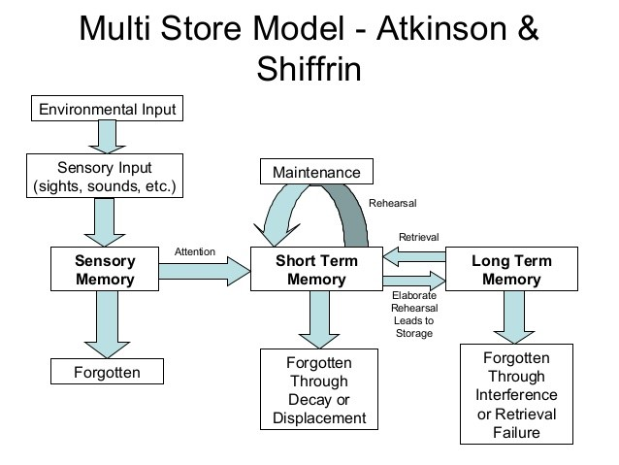

Human development stages
Cognitive information processing (e.g., attention, encoding, retrieval)
Perception and sensemaking
Transfer of learning
Forgetting and retention (e.g., forgetting curve)
System 1 and System 2 brain processes
Expertise and mastery
The way people learn
Factors that affect learning
Instructional methods to enhance learning
Technology to facilitate learning
Methods to evaluate learning objectives

Slide 73
The way people learn
Factors that affect learning
Instructional methods to enhance learning
Technology to facilitate learning
Methods to evaluate learning objectives
Prior experiences
Mental models
Cognitive biases
Motivation
Locus of control
Intrinsic, extraneous, and germane cognitive load
Metacognitive processes

Slide 74
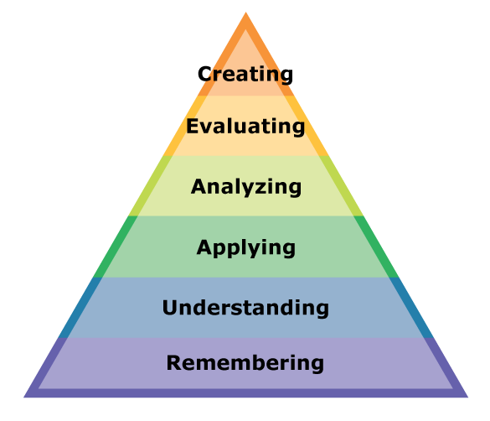
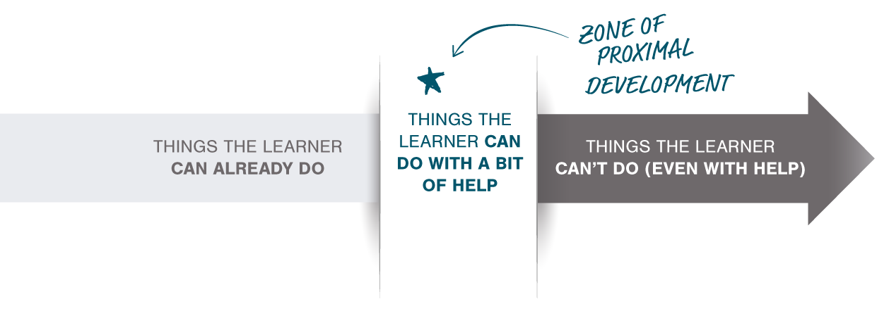
The way people learn
Factors that affect learning
Instructional methods to enhance learning
Technology to facilitate learning
Methods to evaluate learning objectives
Pedagogy, andragogy, and heutagogy techniques
Instructional strategies and tactics
Reflection and practice
Zone of proximal development
Scaffolding
Instructional design processes
Learning taxonomies (e.g., Bloom’s Taxonomy)
Adapting
Mechanizing
Guided Responding
Setting
Perceiving
Originating
Characterization
Organizing
Valuing
Responding
Receiving
Notes:
Krathwohl et al.’s Affective Taxonomy
Simpson’s Psychomotor Taxonomy

Slide 75
The way people learn
Factors that affect learning
Instructional methods to enhance learning
Technology to facilitate learning
Methods to evaluate learning objectives
Traditional “technologies” like paper, books, and chalkboards
Distributed and blended learning
Adaptive learning and intelligent tutors
Games for learning (e.g., gamification, wargames, serious games)
Microlearning
Simulations and scenario-based learning
Live, virtual, and constructive training

Slide 76
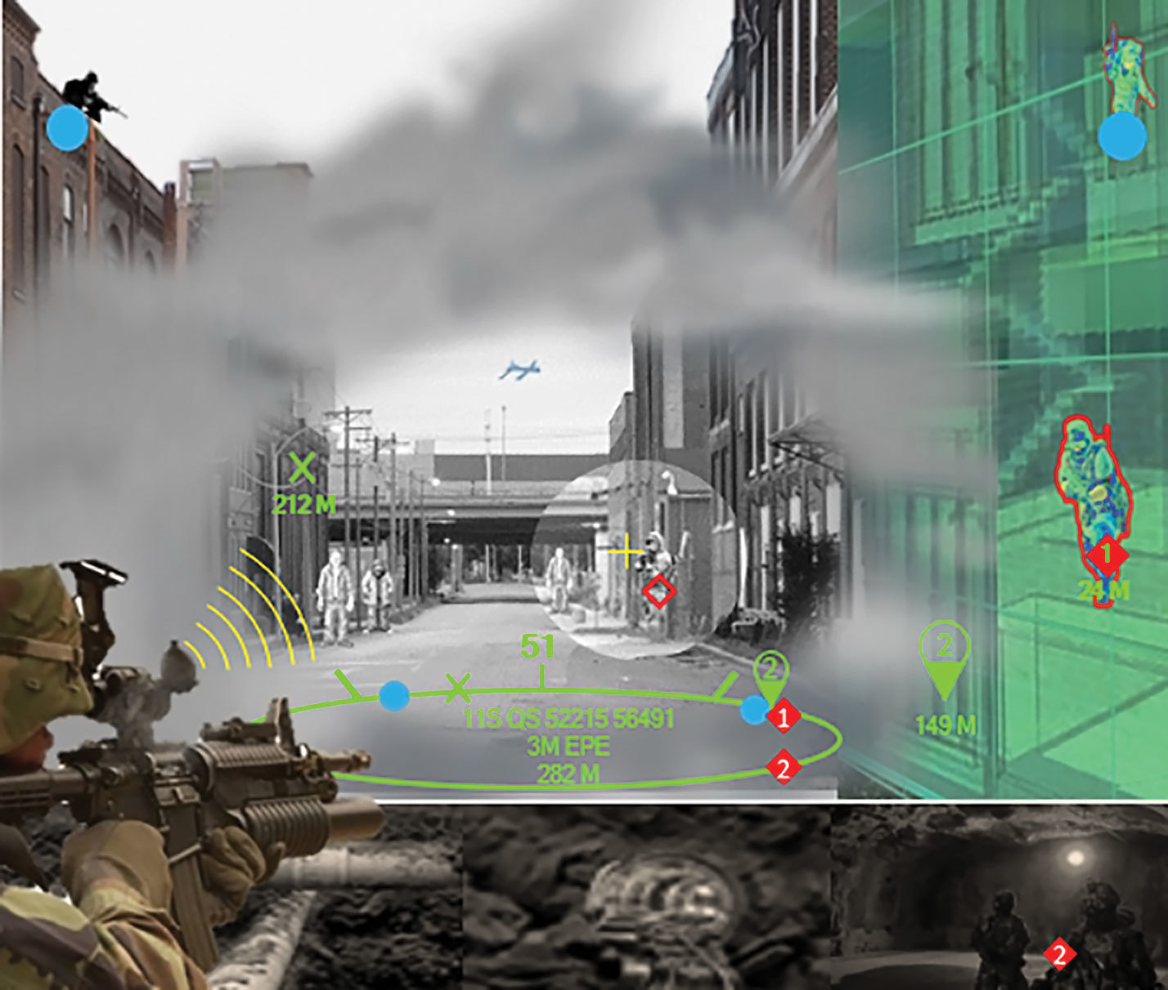
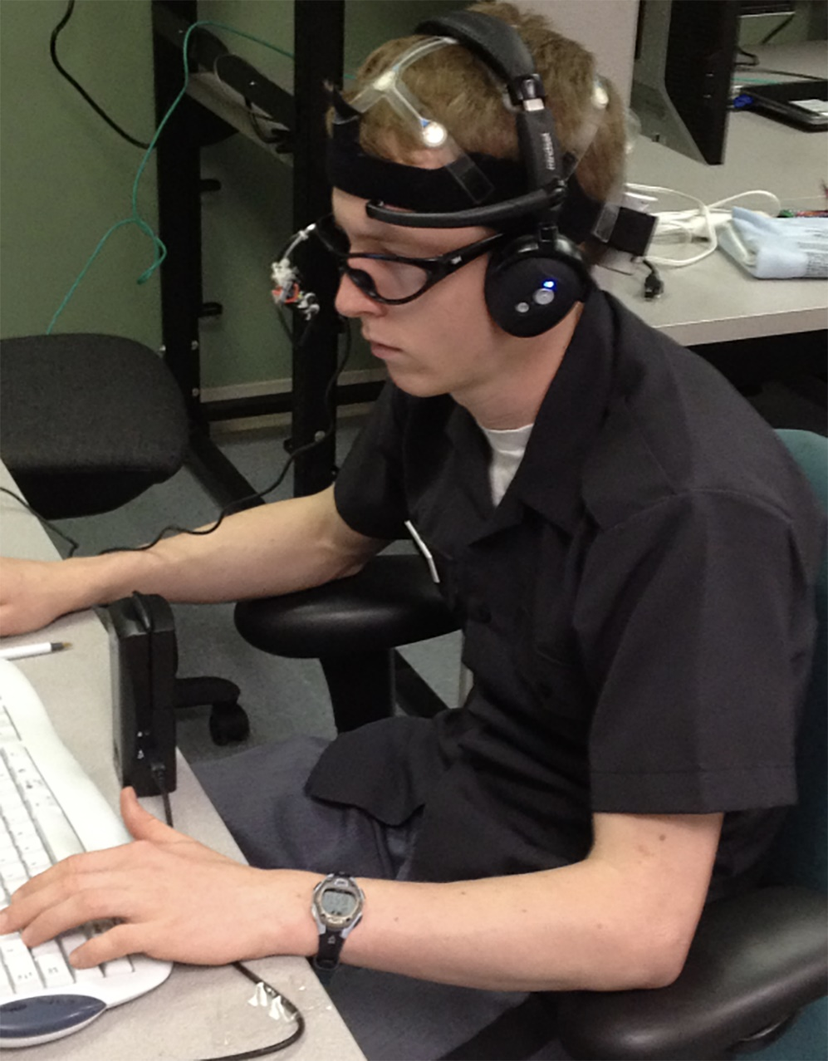

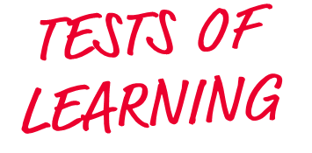




The way people learn
Factors that affect learning
Instructional methods to enhance learning
Technology to facilitate learning
Methods to evaluate learning objectives
Summative and formative assessments
Adaptive assessments
Stealth assessments
Physical and behavioral sensors
Neurophysiological measures
Credentials and micro-credentials
Competency-based and mastery learning
Credit: Robert Sottilare
* Ainsworth, L., & Viegut, D. (2006) Common formative assessments.

Slide 77



















Skill Definition
Activity
Linked Data Stores (Knowledge Model)
Connected via Standards for Linked Metadata
Inferred Data Store
(Learner Model)
INFERENCES
STORED HERE
Context
Detector
Perishability
Standard Detector Plug-ins
Adaptive Engine
Skill Definition
Latent Knowledge Inference
Event Data Store
(xAPI Learning Record Store)
Activity
Misconception Inference
Context
Forgetting Curve
xAPI
Profile
Latent Behavior Inference
Sensors
(Interfaces)
Nudge Impact Predictor
xAPI
xAPI
Notes:
Standard Detector Plug-in Types: One or more algorithms that interpret observed sensor data to predict, classify, infer relationships, or make other extrapolations. Example plug-in algorithms:
• Latent knowledge inference
• Misconception missed step inference
• Forgetting curve
• Latent behavior inference
• Metacognitive nudge impact predictor
Standards for instrumentation are used to collect data used by adaptive systems that adjust learning experiences in near-real time. [click] These systems use artificial intelligence to infer if a learner knows or can do something, how well, and what kinds of experiences might best help the learner develop a particular competence.

